Slide 1
Case Study - Monexo
Apr 2016

Slide 2
How do Monexo sign contract with Lenders and Borrowers?
Lenders/Borrowers register as member at Monexo website:
https://www.monexo.co/en/members/register
Input personal details and accept Terms & Condition
Upload required personal documents and sign contract online (No Face-to-Face meeting is needed)

Slide 3
How do Monexo source Lenders and Borrowers?
 | Lenders | Borrowers
Social Media 1) YouTube 2) LinkedIn 3) Twitter | √ | √
Education seminar | √ | X
Publicity Interview by TV Interview by newspaper | √ | √
Keyword search | X | X
Offline sales team | X | X

Slide 4
What are the costs for sourcing Lenders and Borrowers?
 | Cost
YouTube | Free
LinkedIn | Free
Twitter | Free
Education seminar | $2500 rental cost per seminar Free for Eventbrite
Interview by TV | Free
Interview by newspaper | Free

Slide 5
Fund transfer mechanism for Lenders and Borrowers
Lenders | Borrowers
The lender transfers money from the bank account that he provided in the application process to the HKTC-Monexo Administrative Account. | Monexo will disburse the money to borrower’s designated bank account as per the processing time taken by the bank.

Slide 6
Return and costs for Lenders and Borrowers
Return and costs for Lenders | Costs for Borrowers
(Return) Interest rates from 7% to 15% based on risk appetite | (Cost) Interest rates on the loans from 7.73% to 32.55% for Personal Installment Loan and 7% to 22% for Rent Cash-in Loan.
(Cost) An one-time non-refundable application fee | (Cost) A fixed non-refundable application fee to register as a borrower at Monexo.
(Cost) A servicing fee to a percentage of the monthly loan repayments from borrowers. | (Cost) A servicing fee (2% to 4% on funded loan amount) depending on borrower’s Monexo rating which will be deducted by the trust company from loan disbursement prior to depositing the funds in borrower’s account.

Slide 7
Minimum investment amount and average loan size at Monexo
As a lender, the minimum amount currently require to open a new account is HKD 100,000.
The current average loan size is HKD 300,000

Slide 8
Finance model for Monexo
Income
Membership application fee from both lenders and borrowers (one-off)
A servicing fee to a percentage of the monthly loan repayments charged on lenders (monthly)
A servicing fee (2% to 4% on funded loan amount) charged on borrowers (one-off)
Expenses
Office rental
Staff costs
Website and mobile APP operation
System maintenance
Advertising

Slide 9
Lenders
Print Screen + T&C

Slide 10
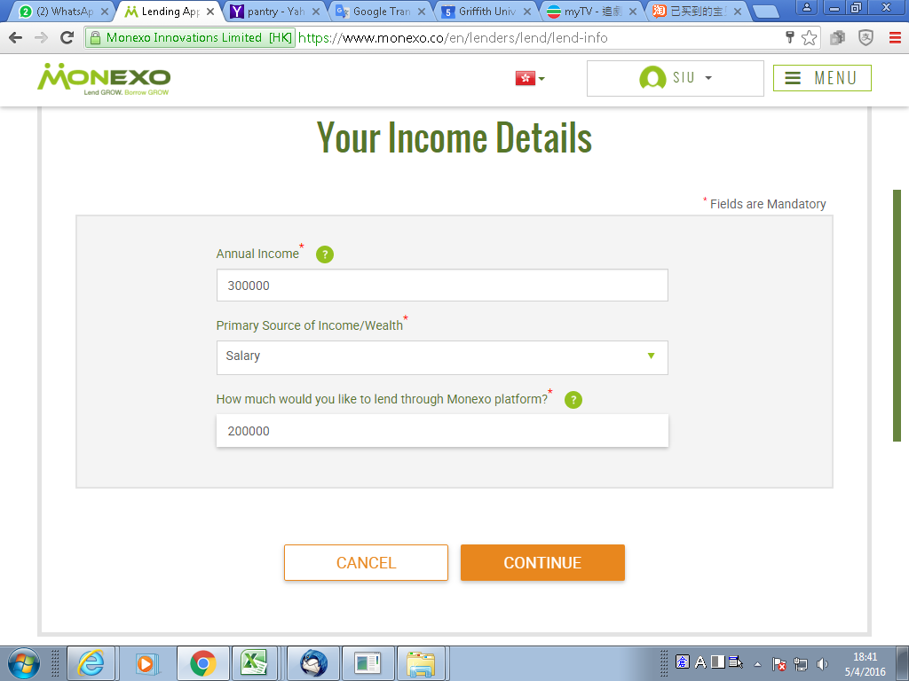

Slide 11
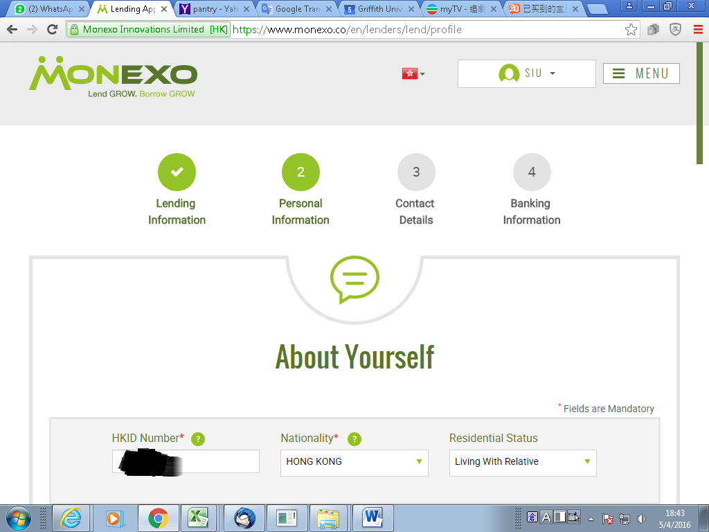

Slide 12
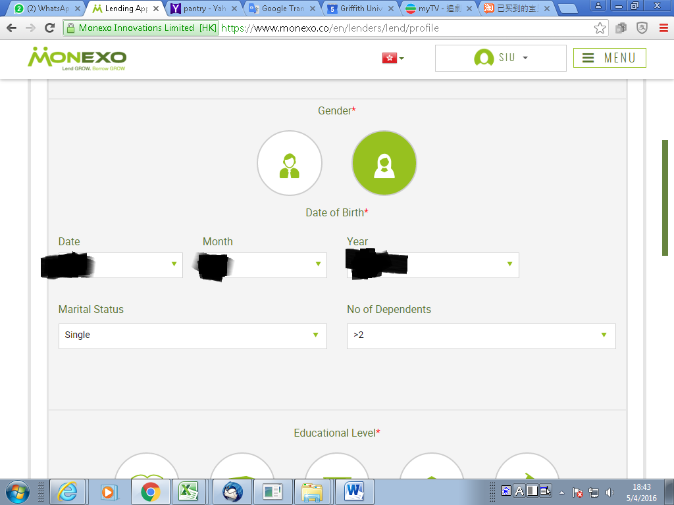

Slide 13
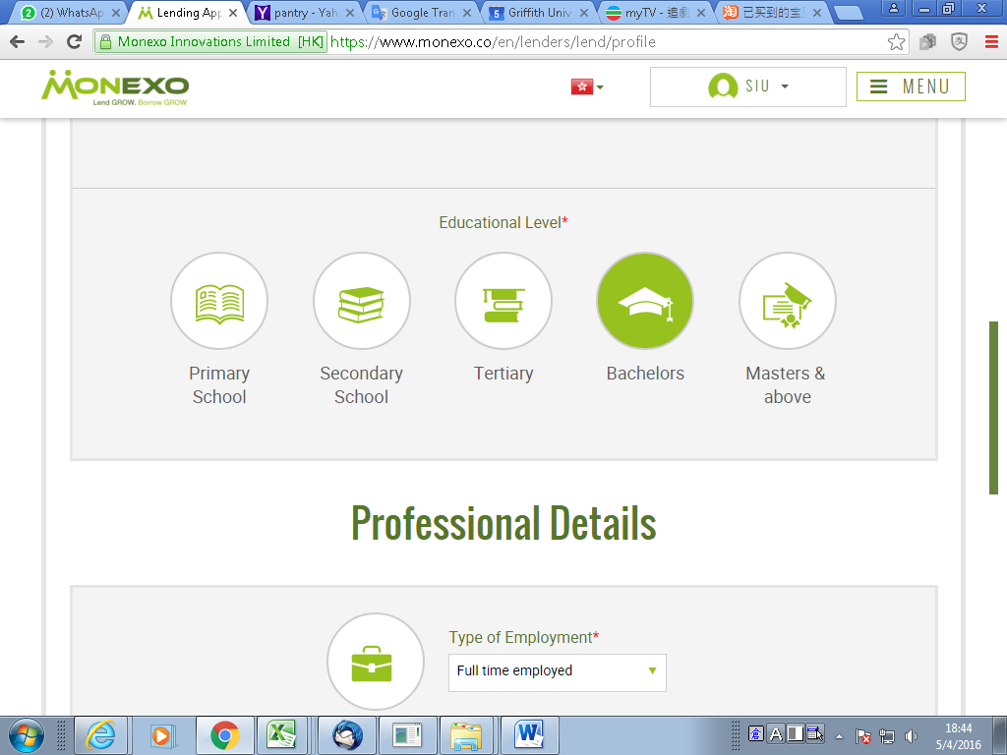

Slide 14
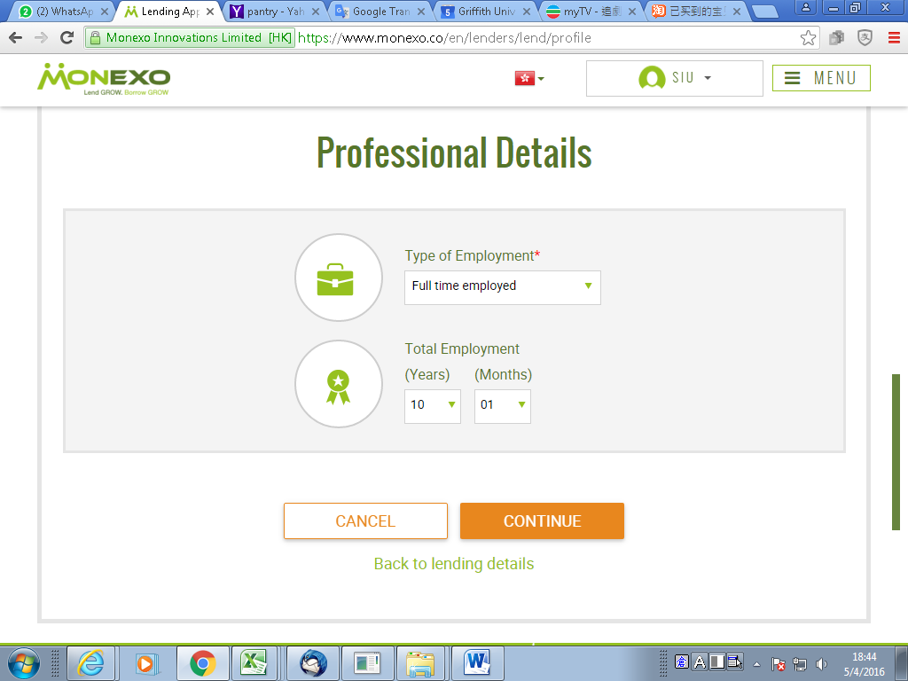

Slide 15
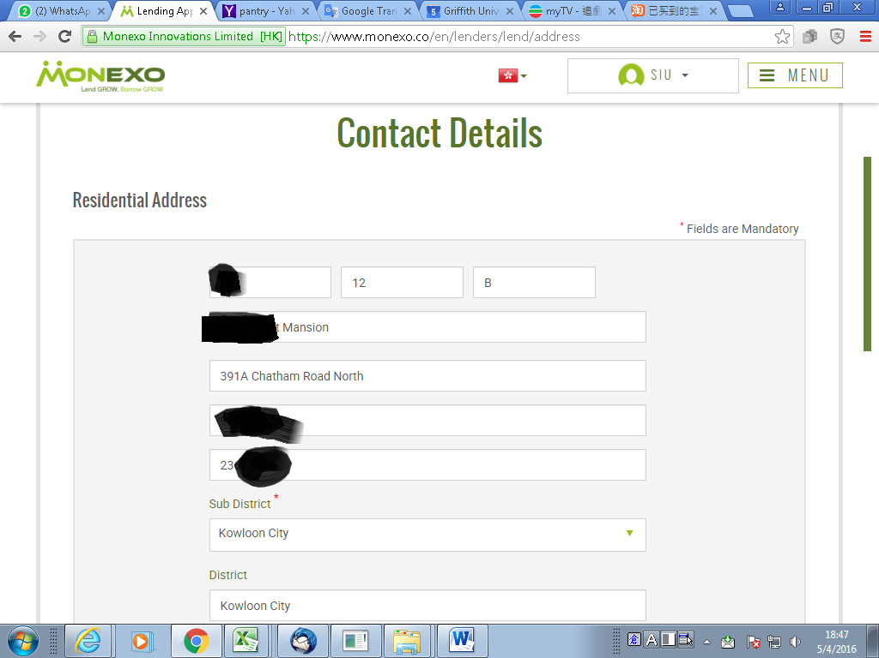

Slide 16
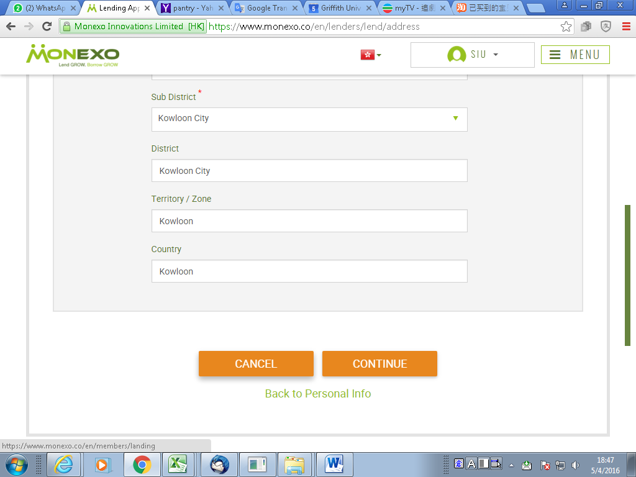

Slide 17
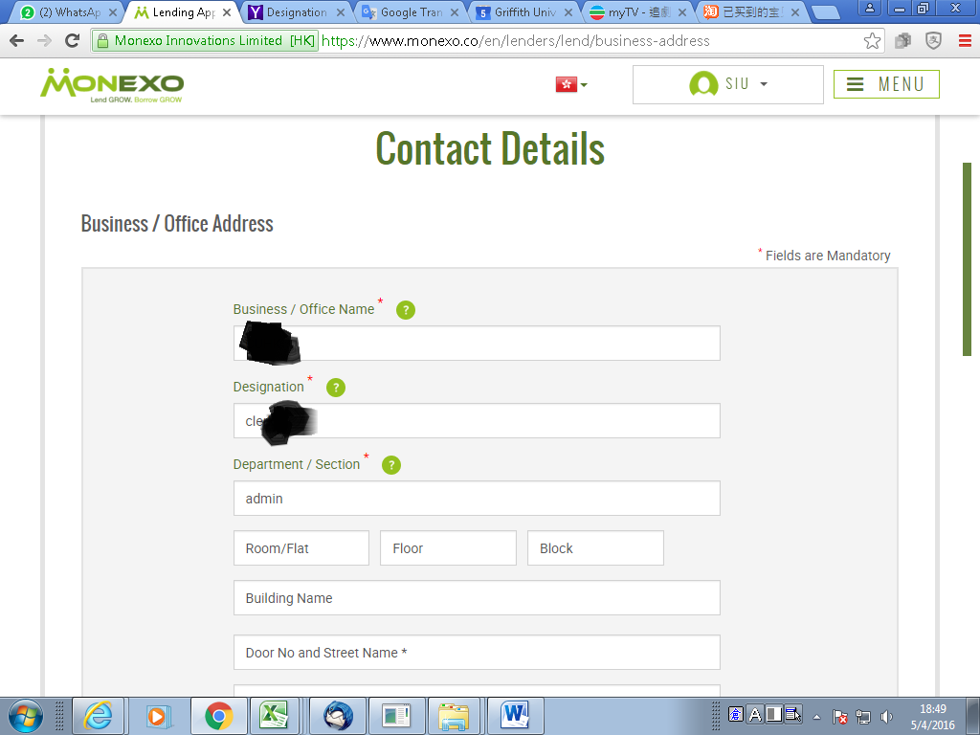

Slide 18
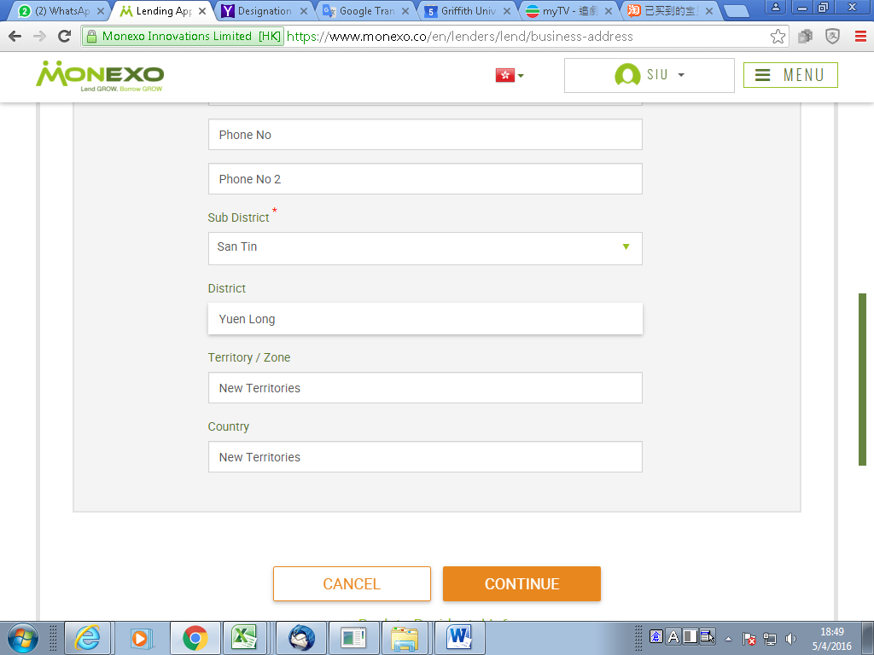

Slide 19
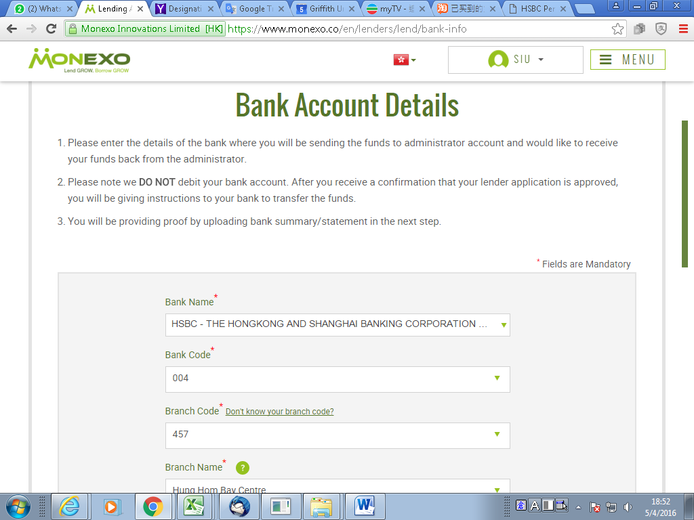

Slide 20
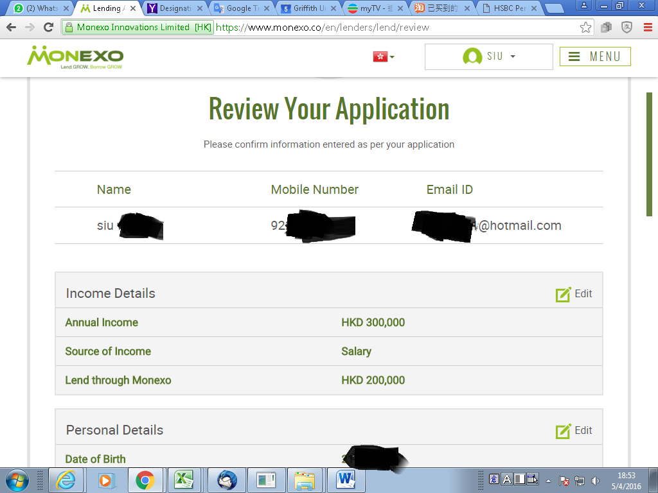

Slide 21
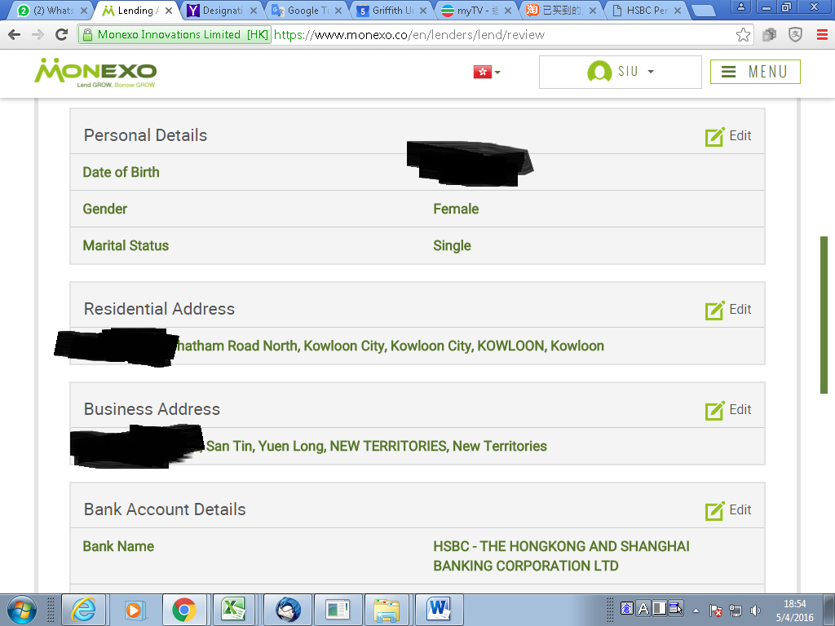

Slide 22
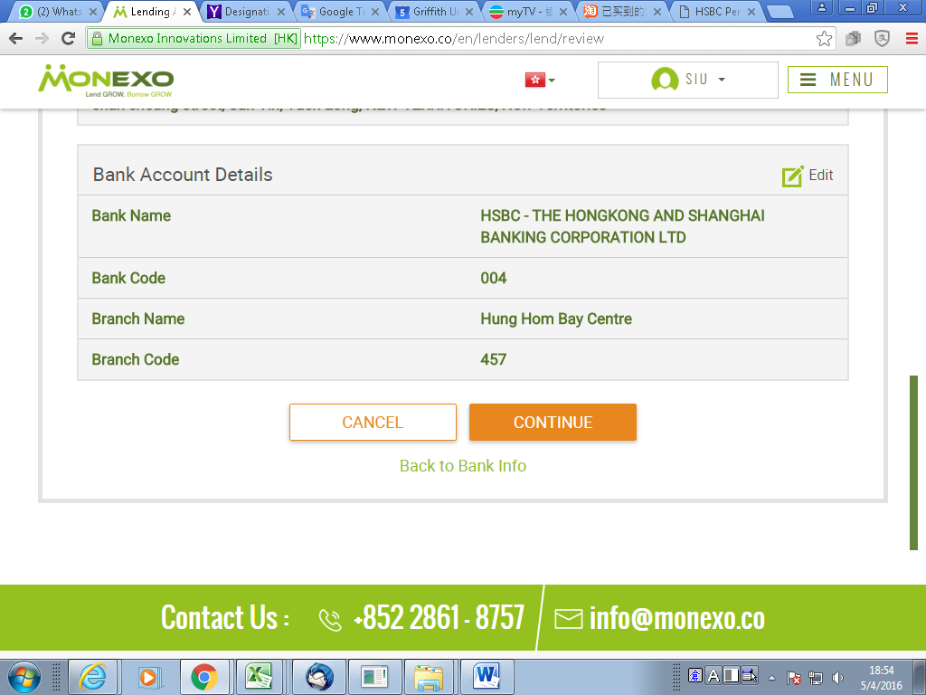

Slide 23
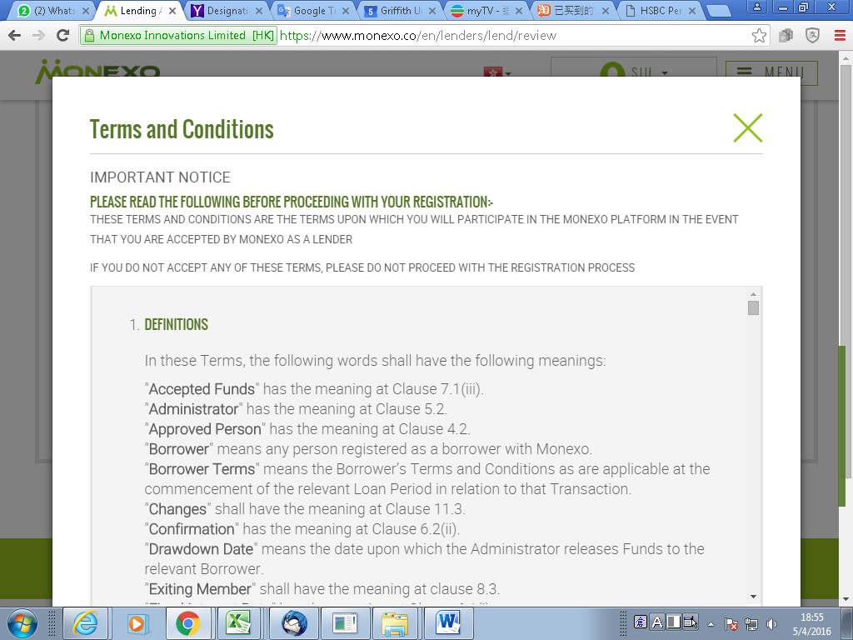

Slide 24
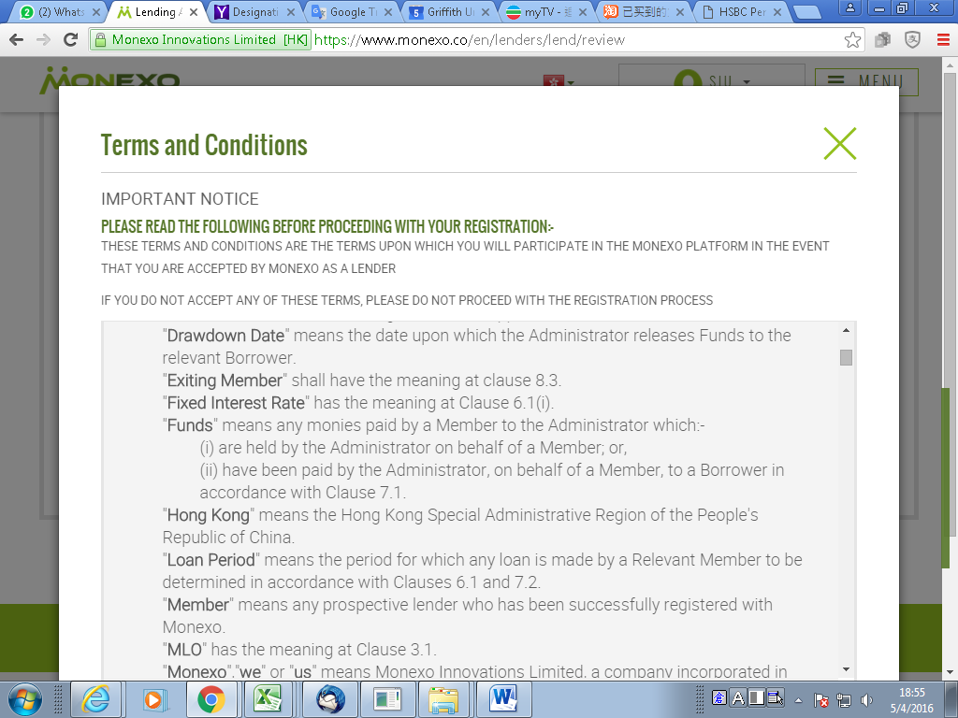

Slide 25


Slide 26
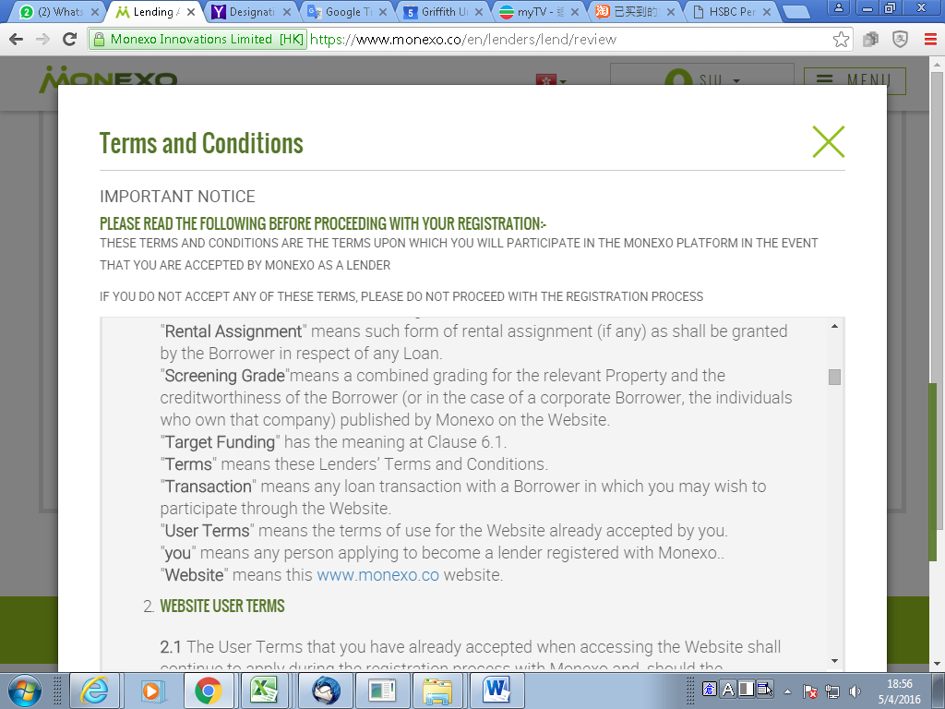

Slide 27
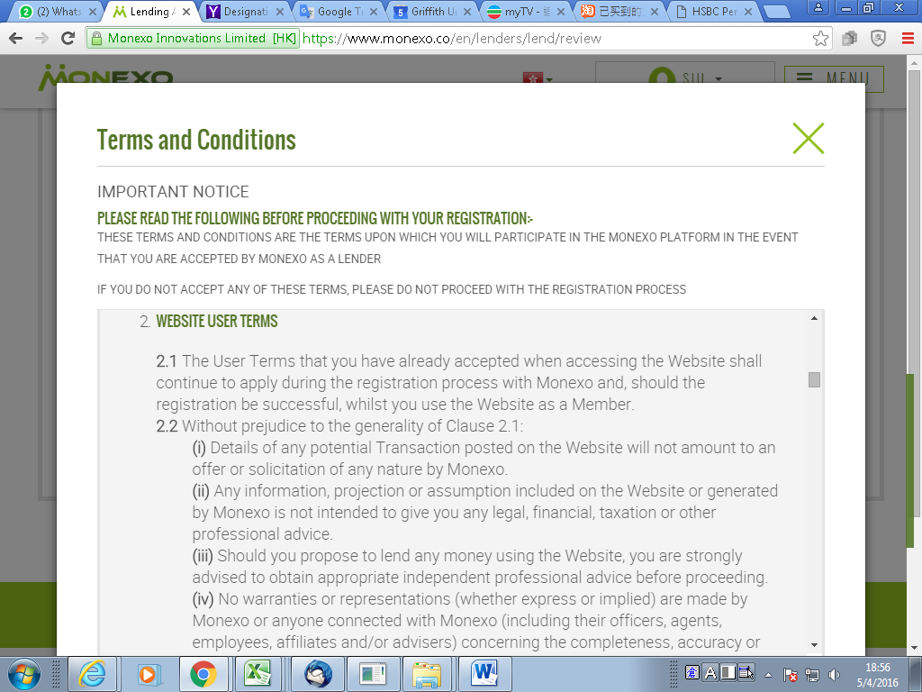

Slide 28
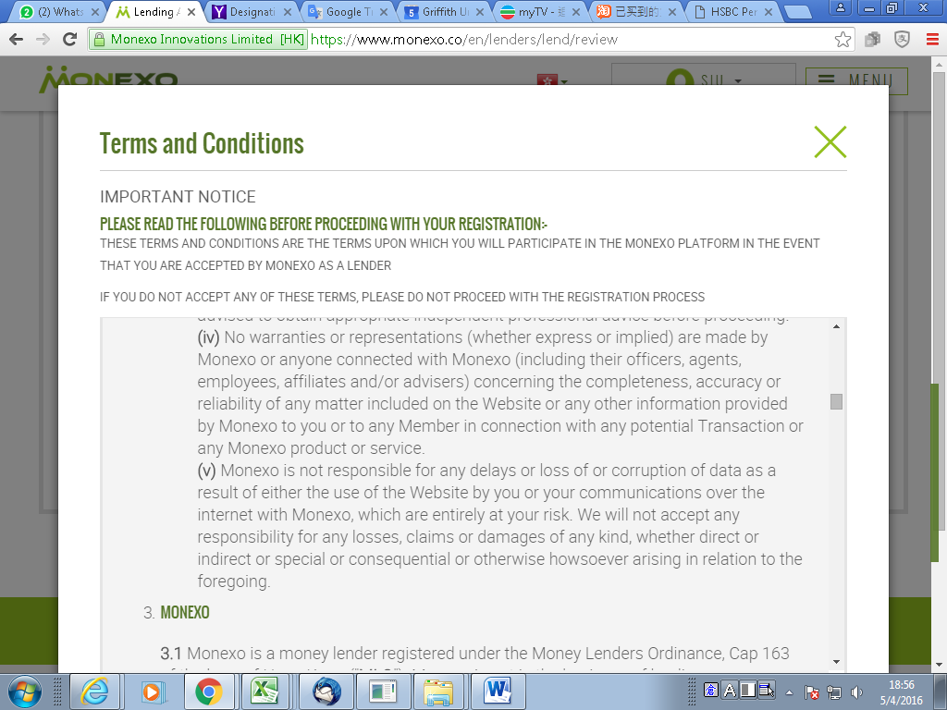

Slide 29
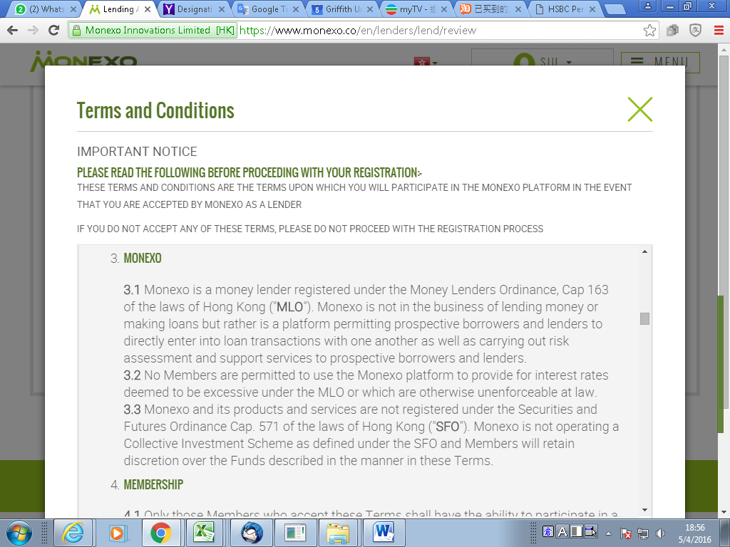

Slide 30


Slide 31
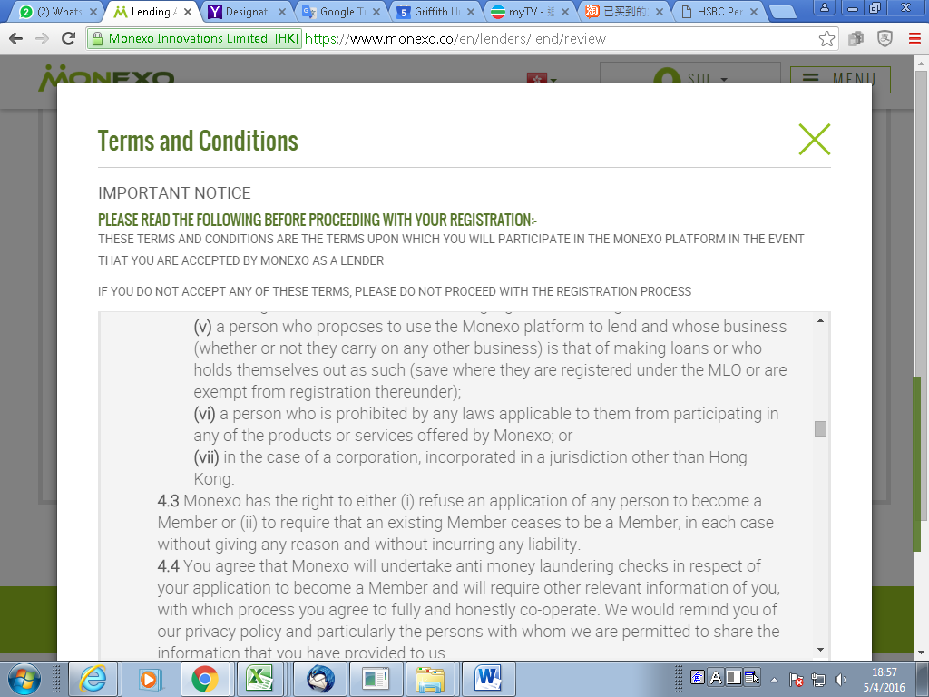

Slide 32


Slide 33


Slide 34


Slide 35


Slide 36
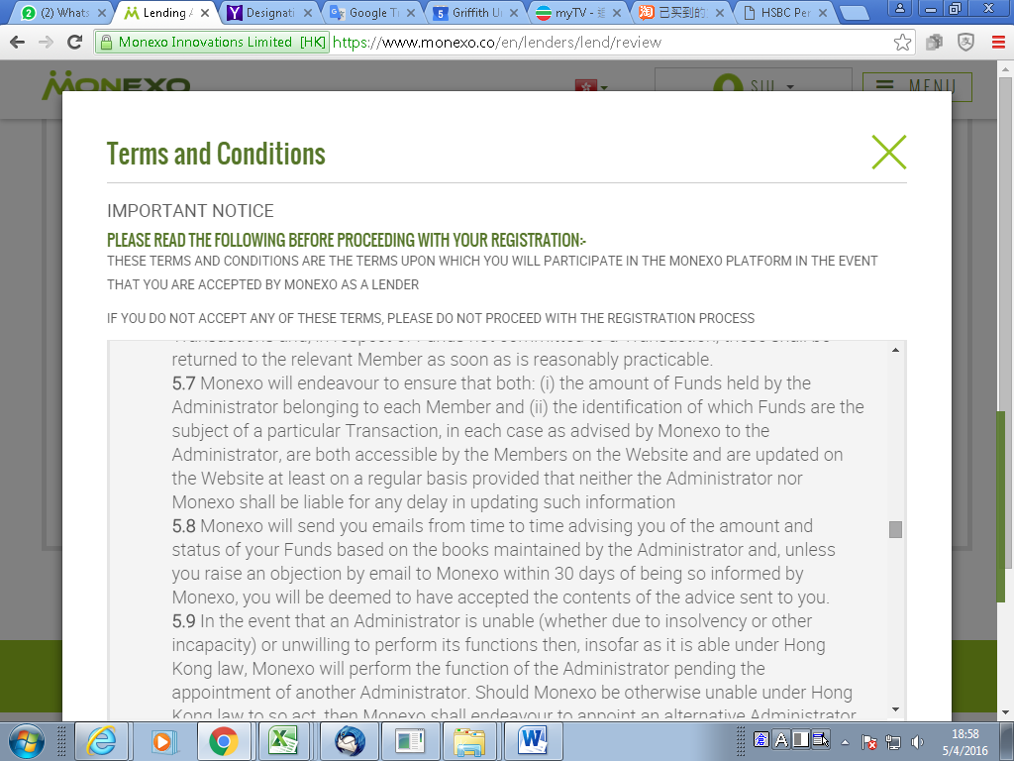

Slide 37
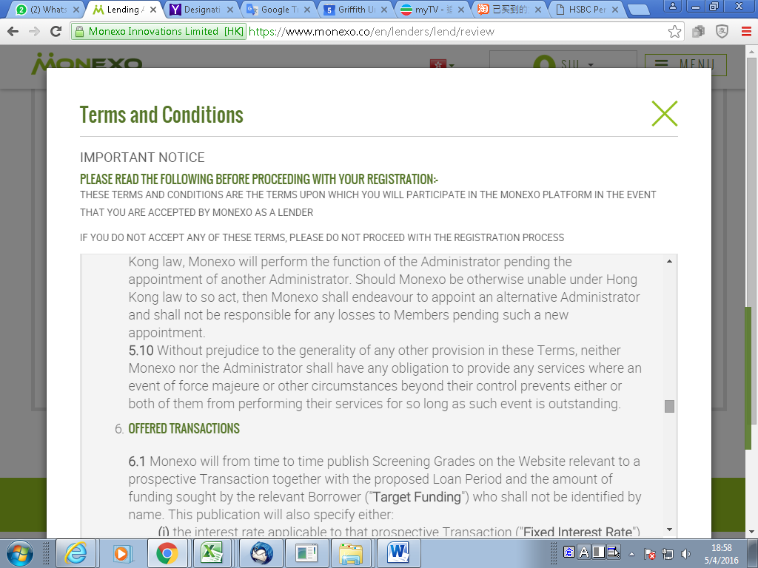

Slide 38
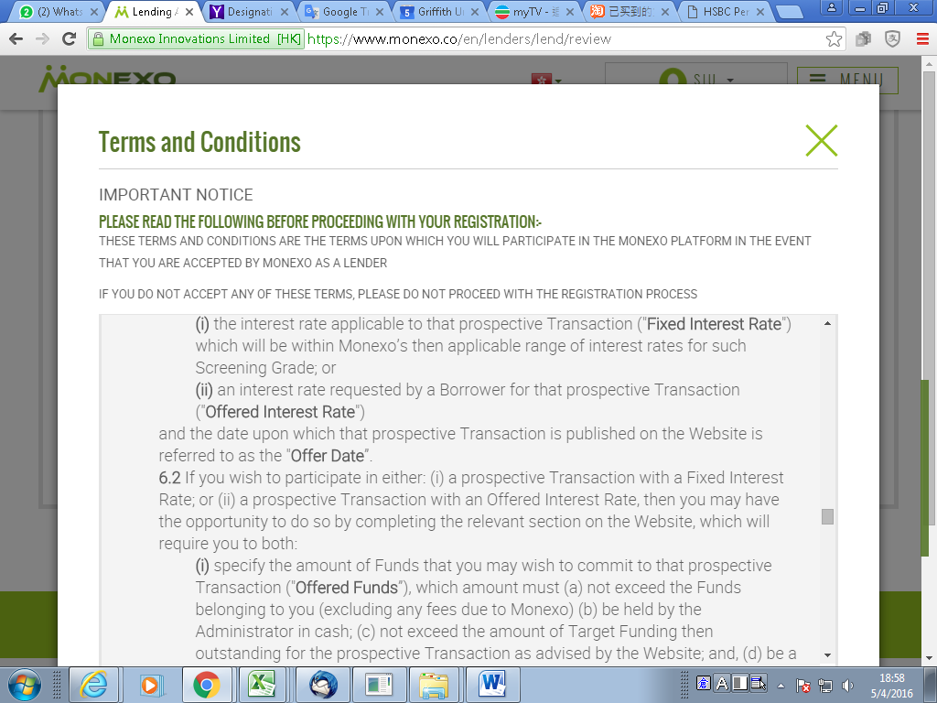

Slide 39
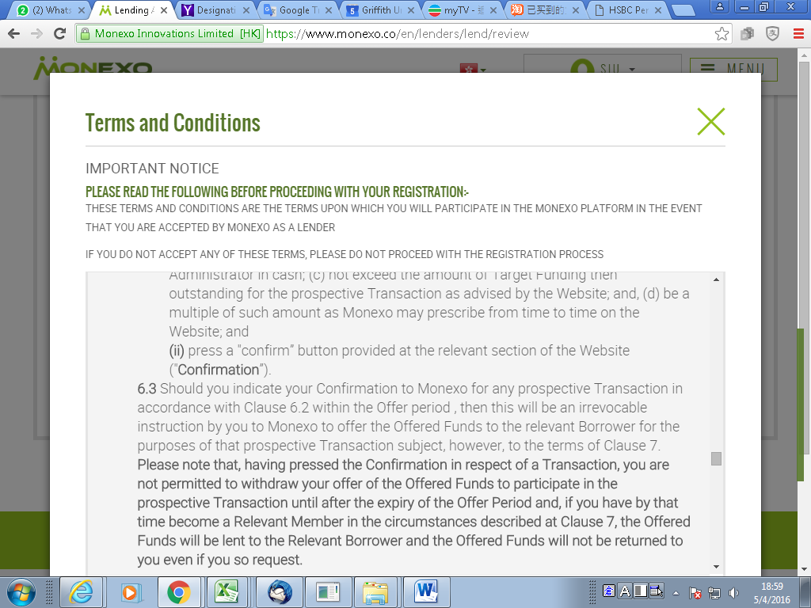

Slide 40


Slide 41
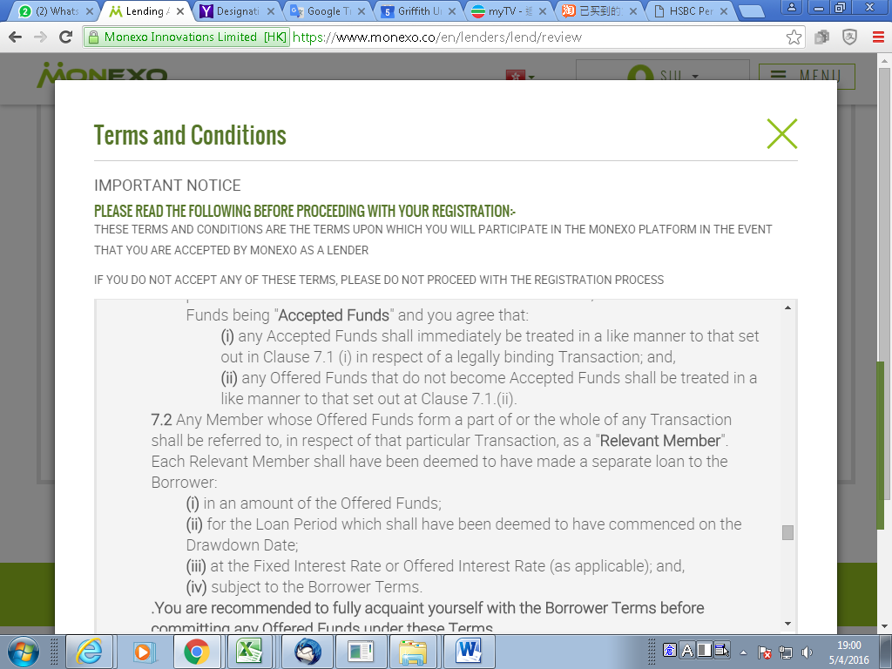

Slide 42


Slide 43
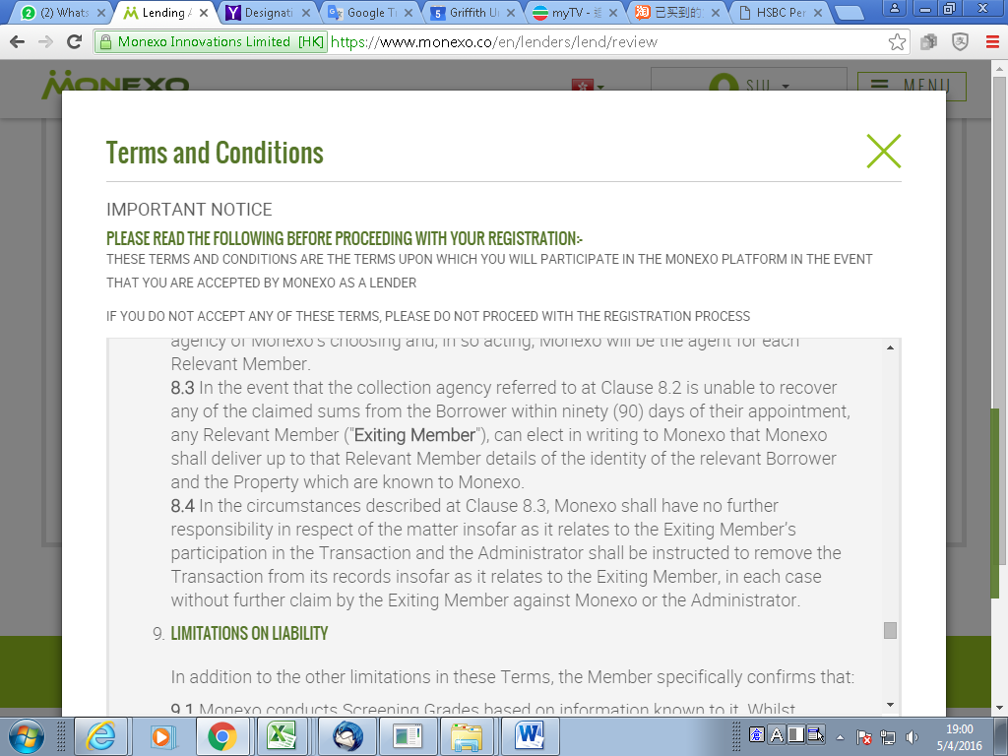

Slide 44
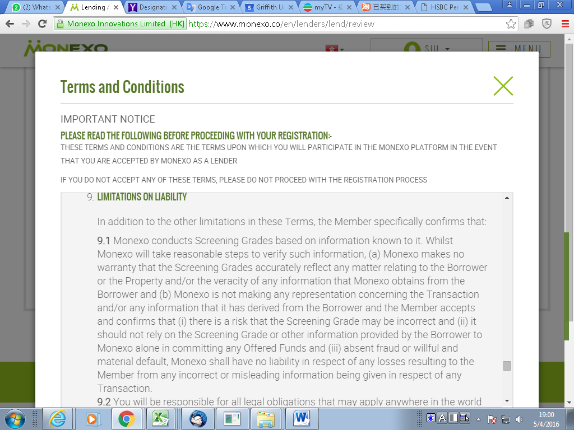

Slide 45
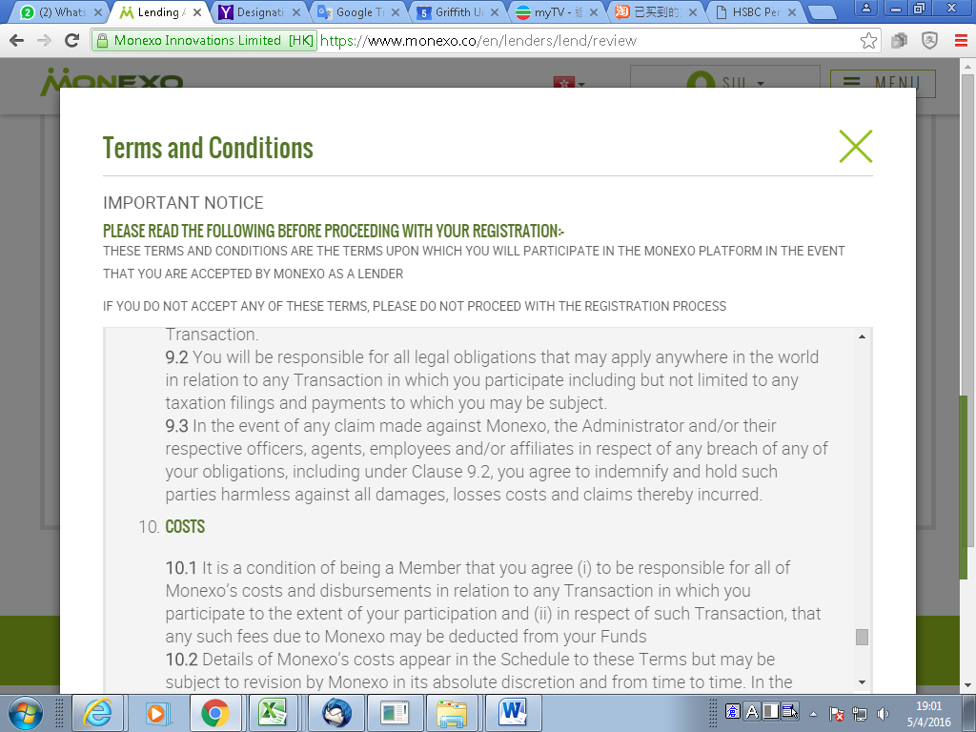

Slide 46
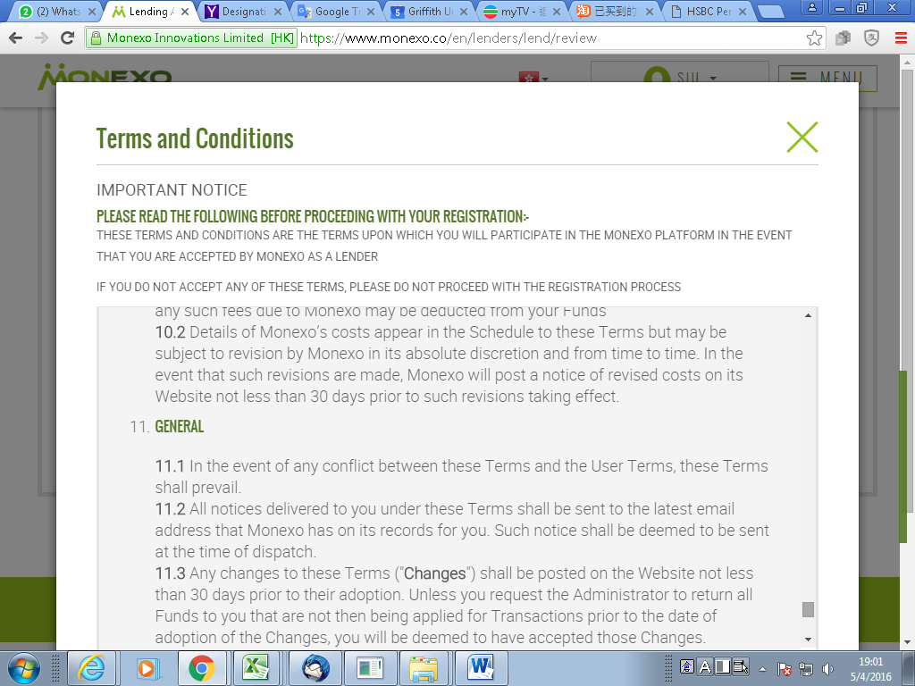

Slide 47
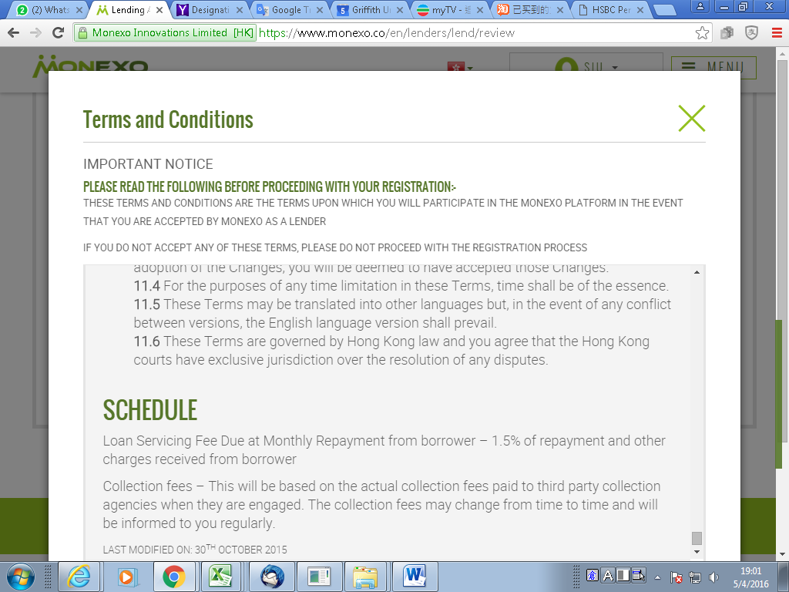

Slide 48
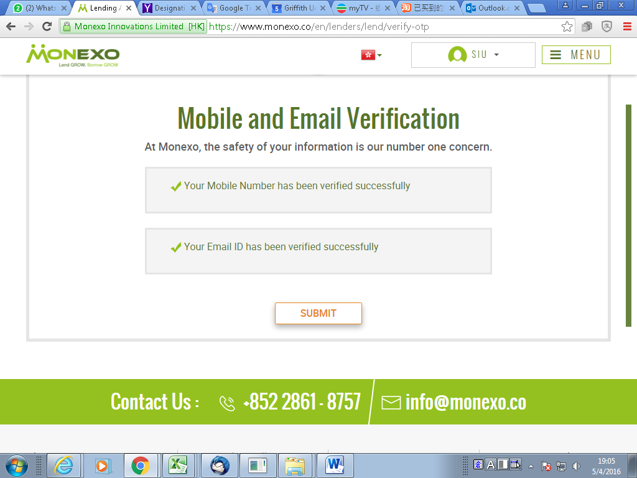

Slide 49
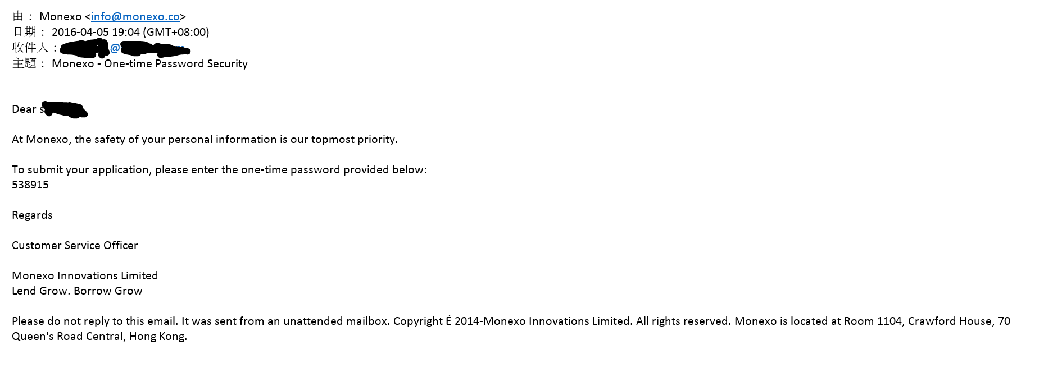
Email for one time password

Slide 50
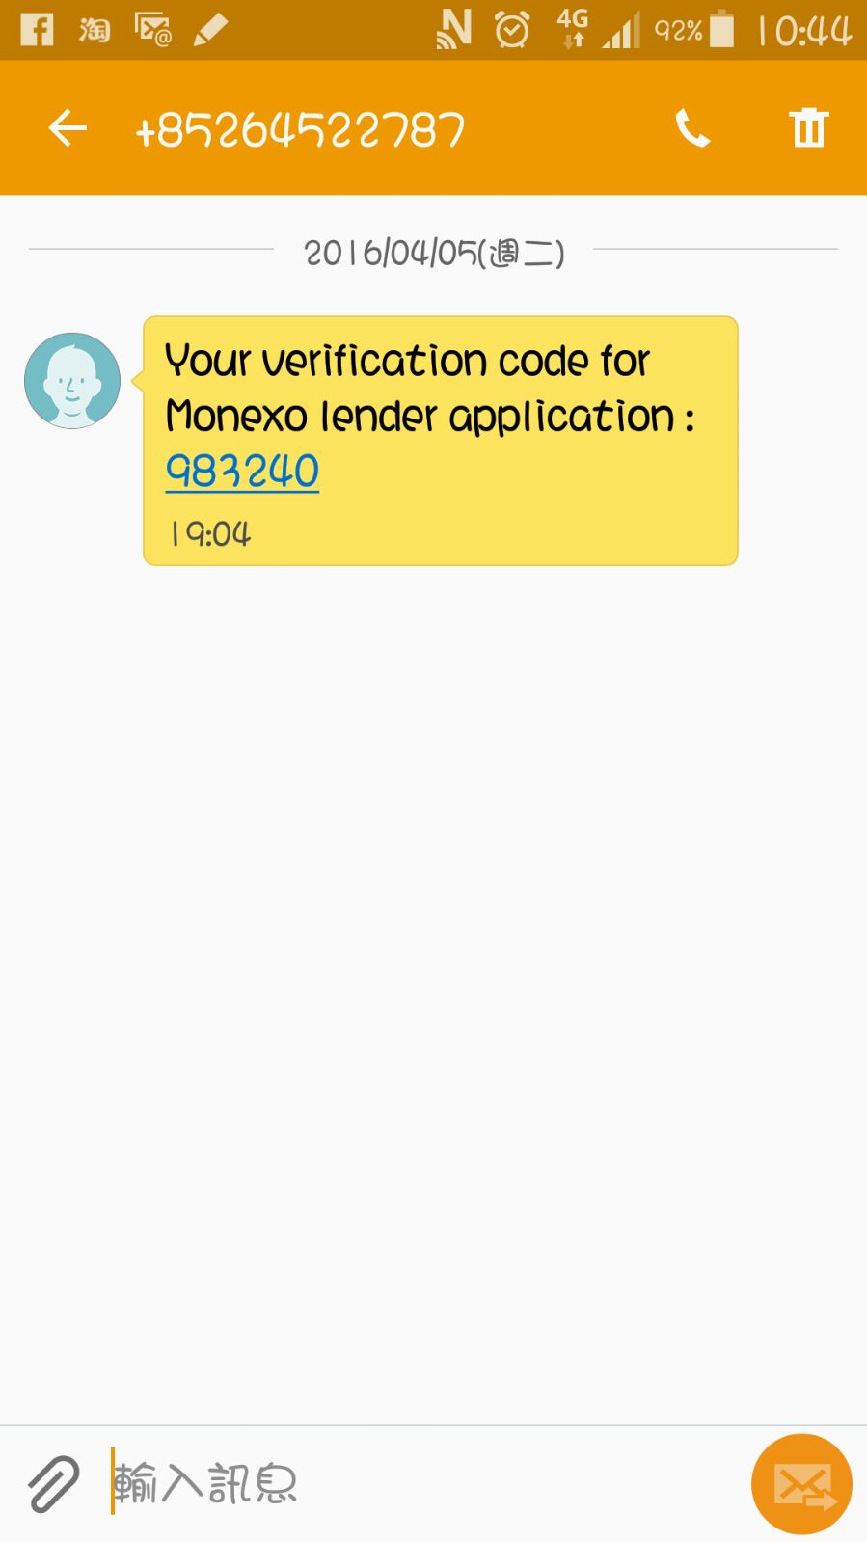
Phone Verification

Slide 51
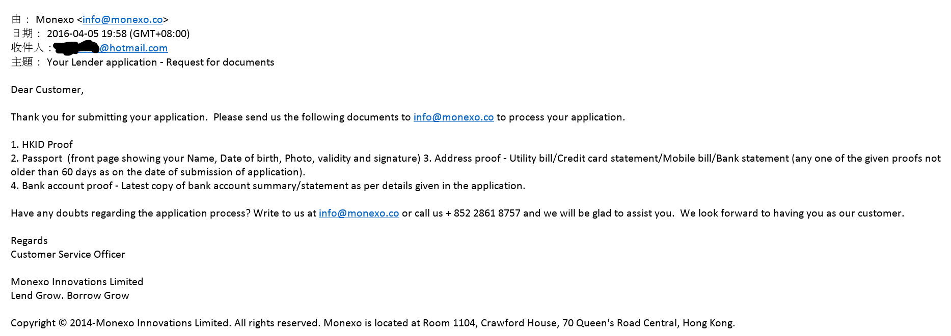
Email for requesting documents

Slide 52
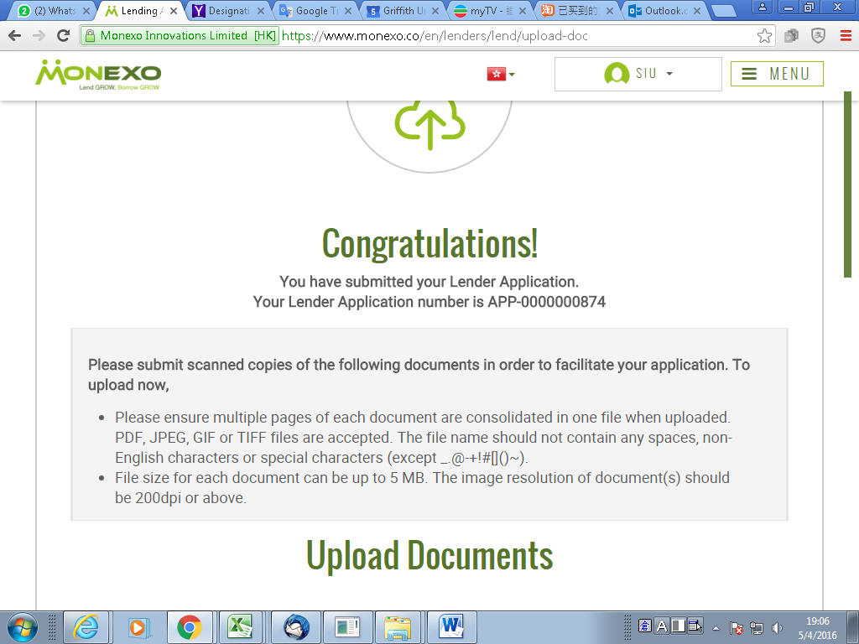

Slide 53
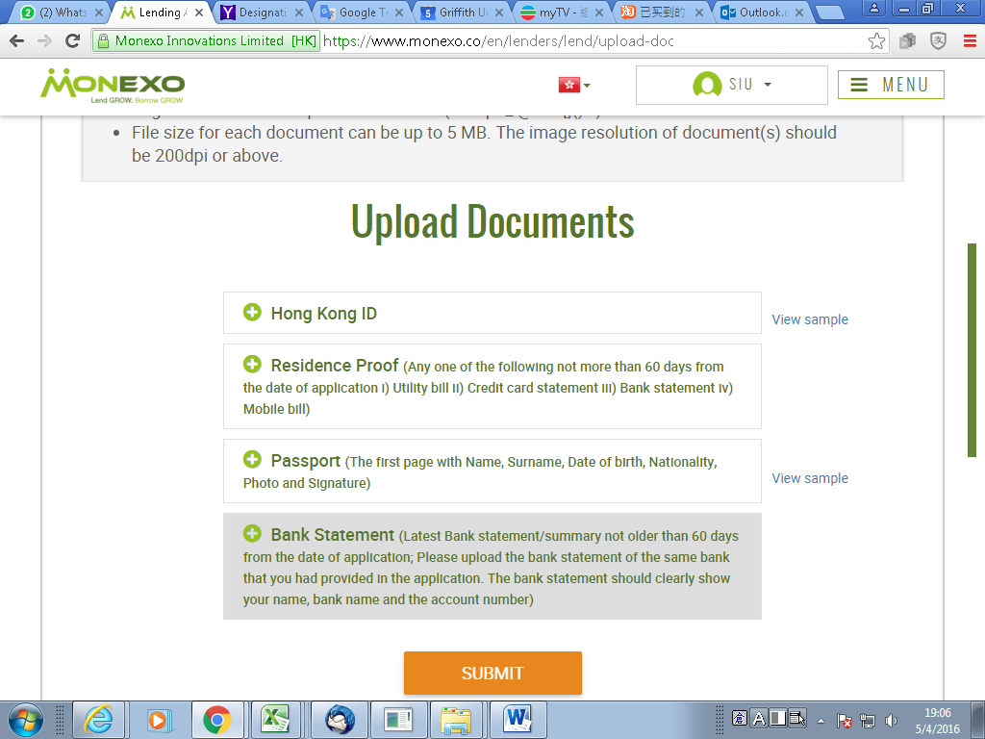

Slide 54
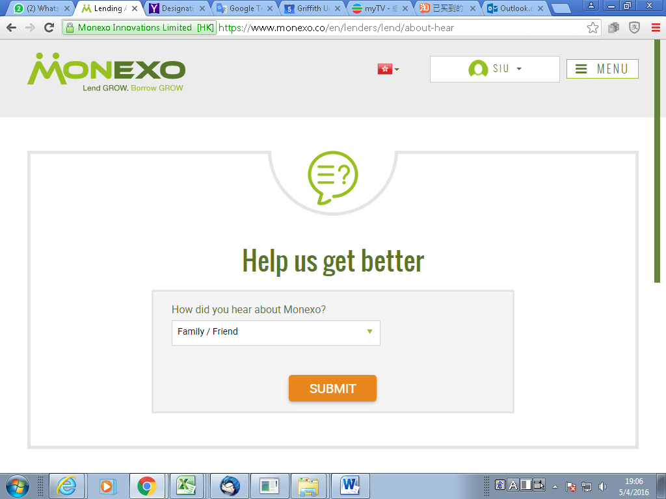

Slide 55
Borrowers
Print Screen + T&C

Slide 56
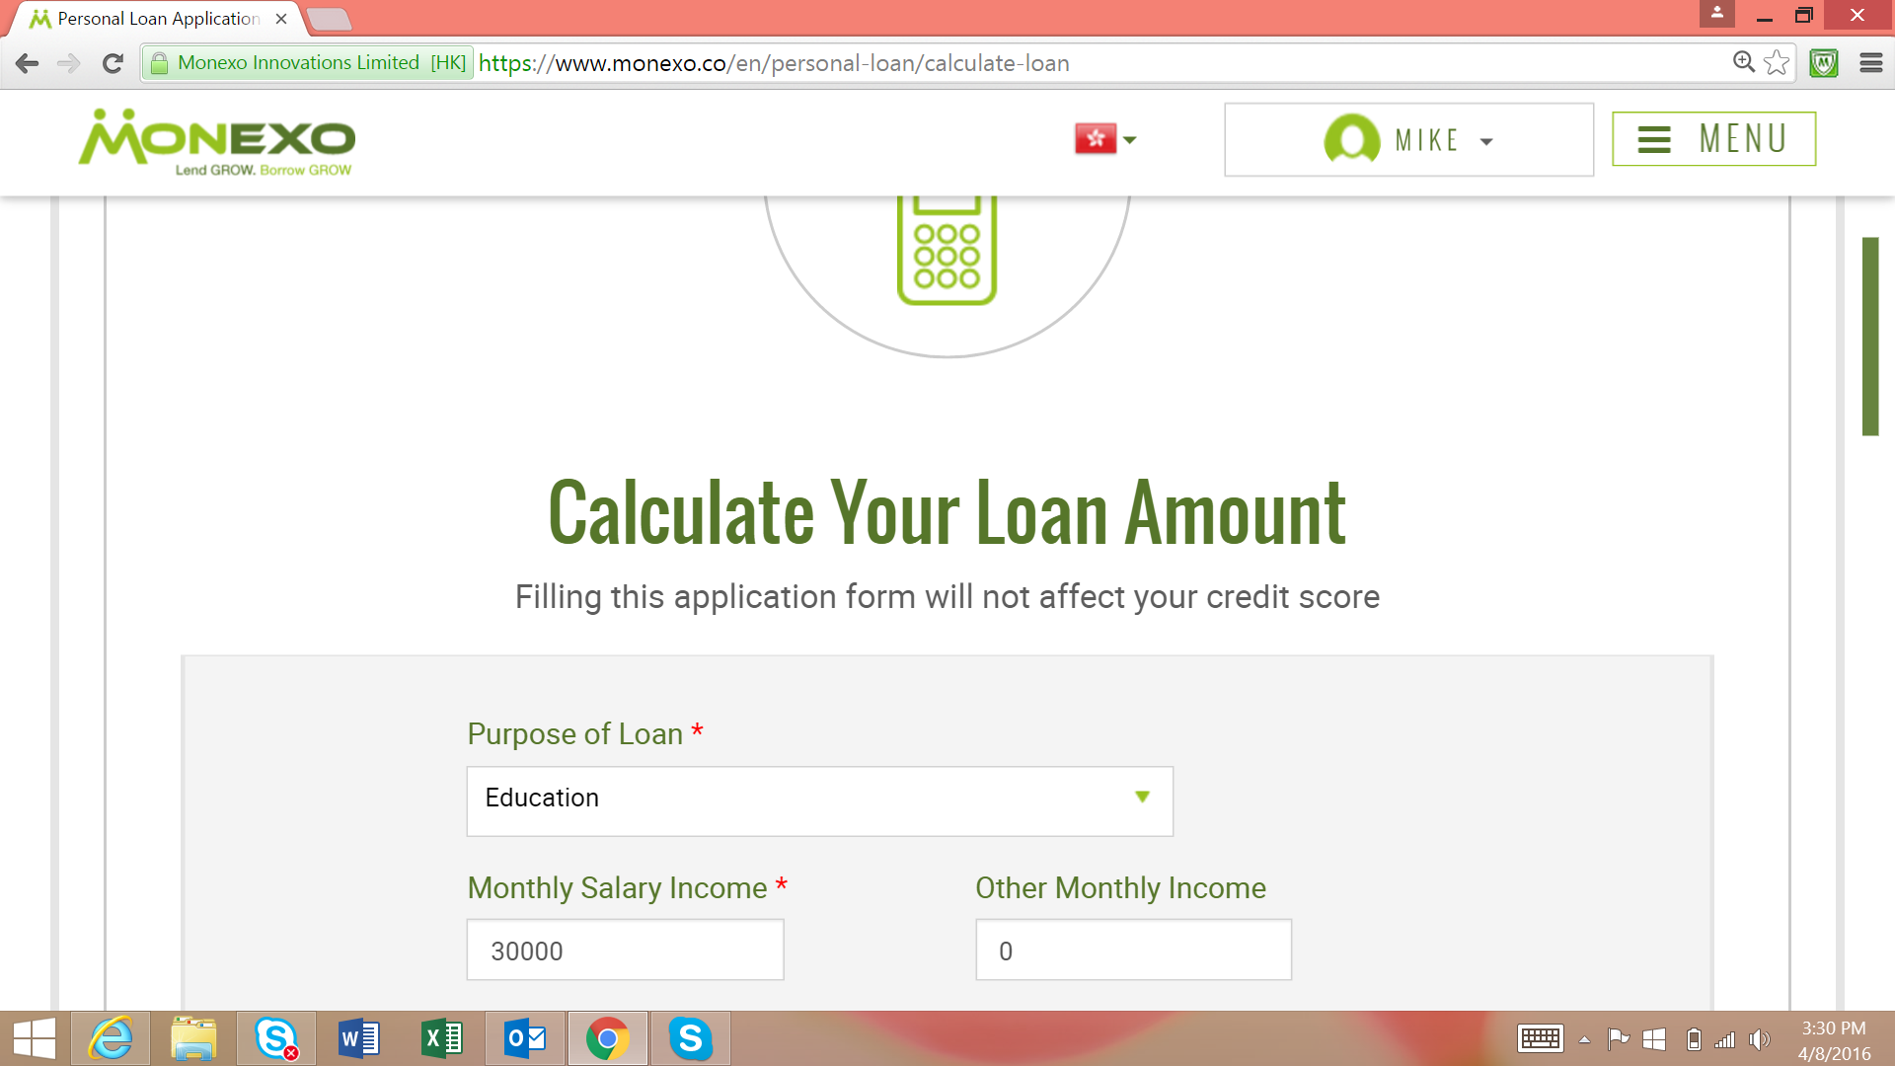

Slide 57
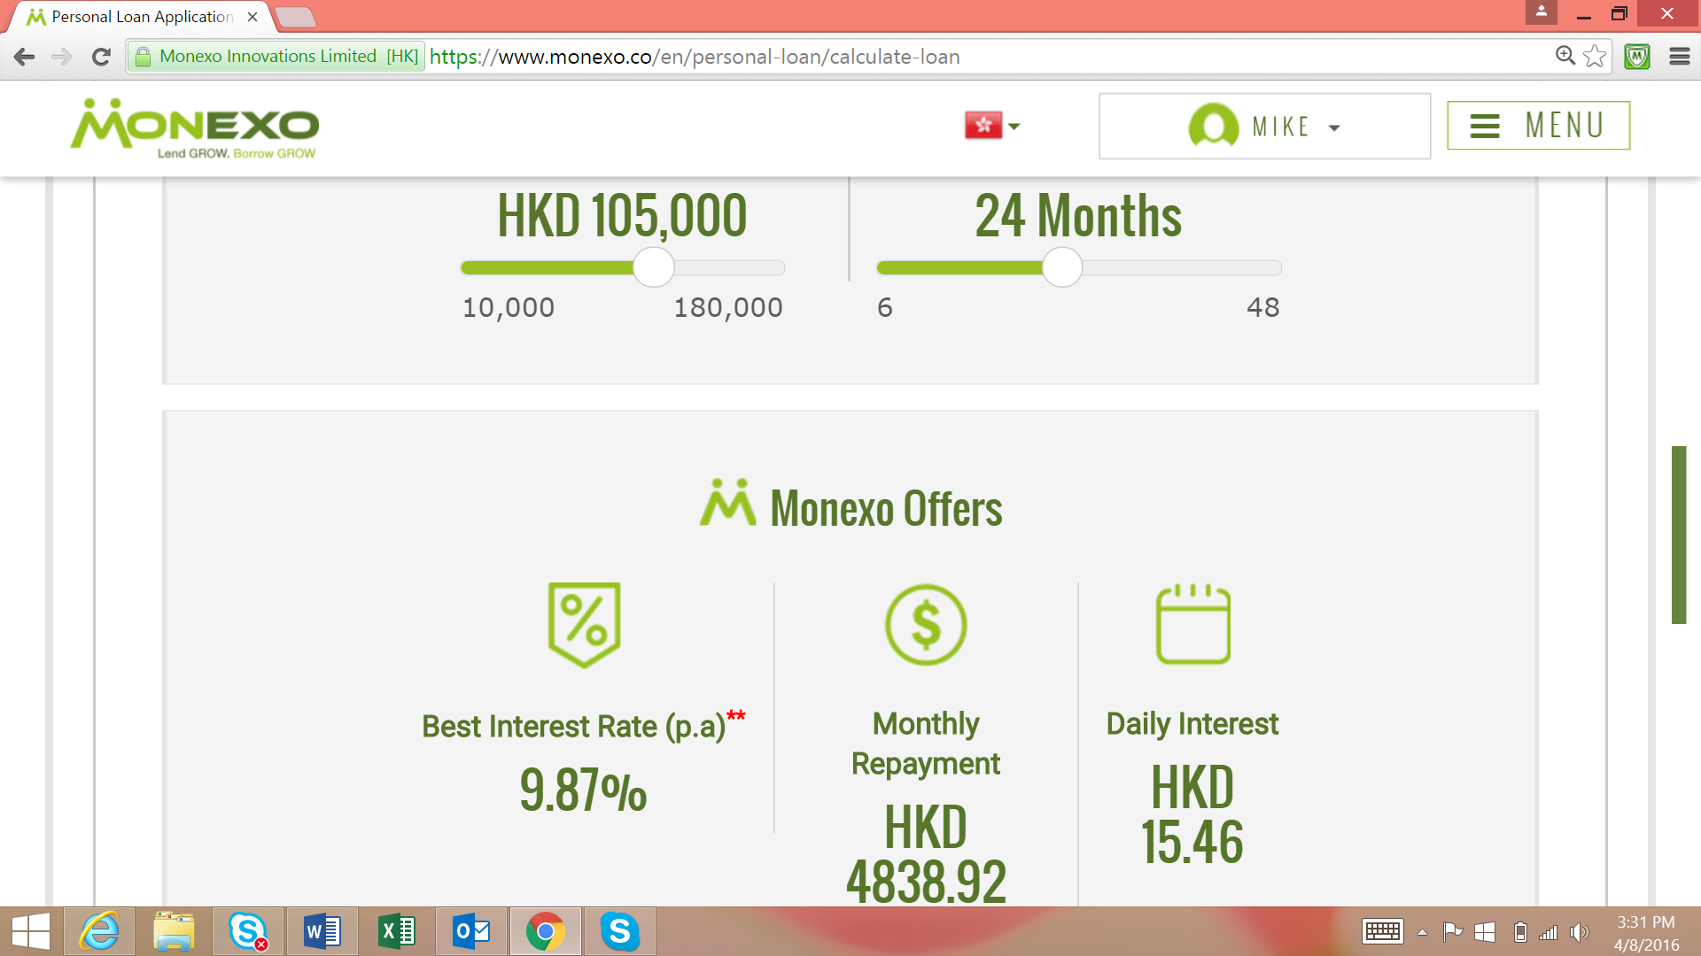

Slide 58
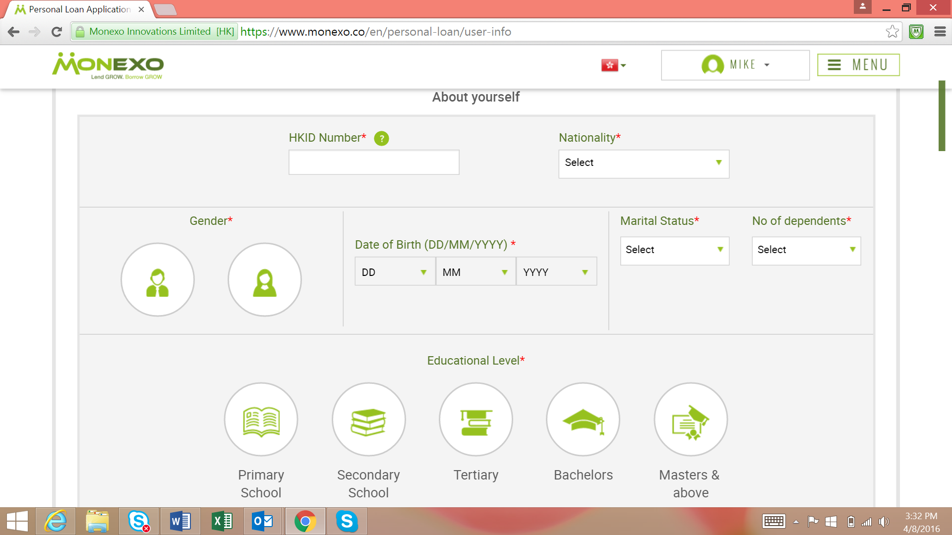

Slide 59
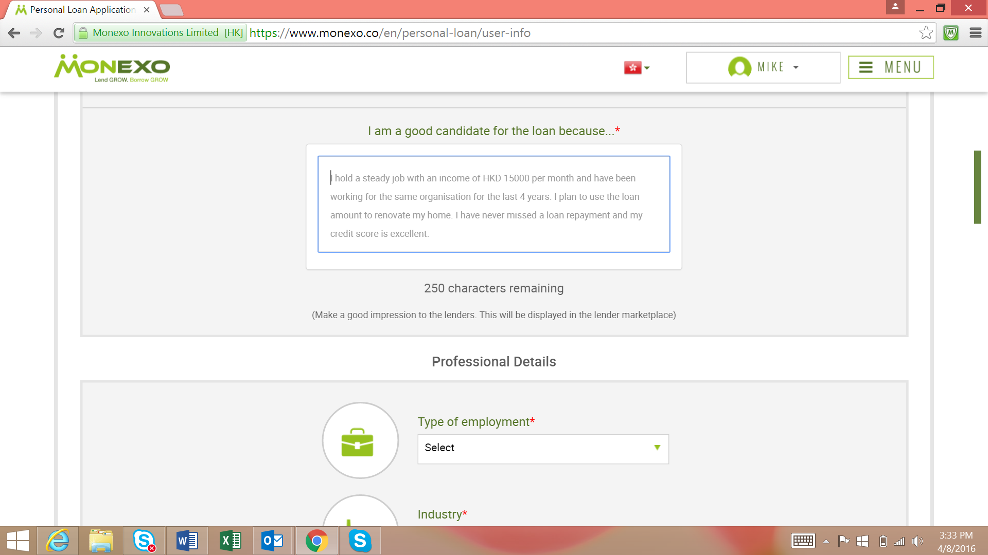

Slide 60
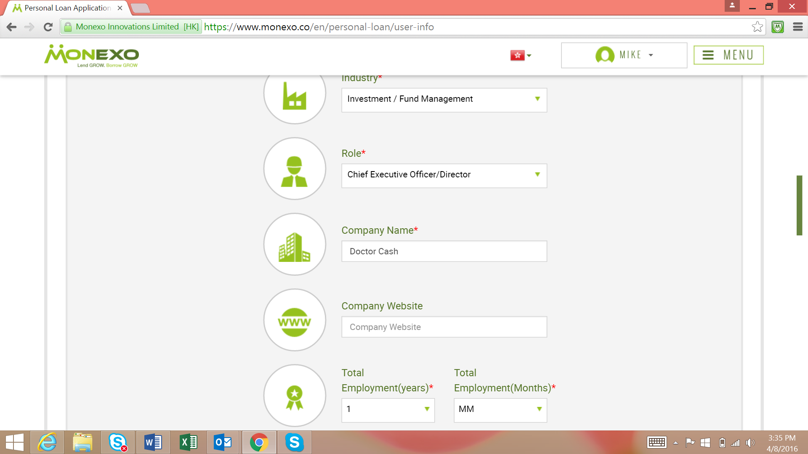

Slide 61
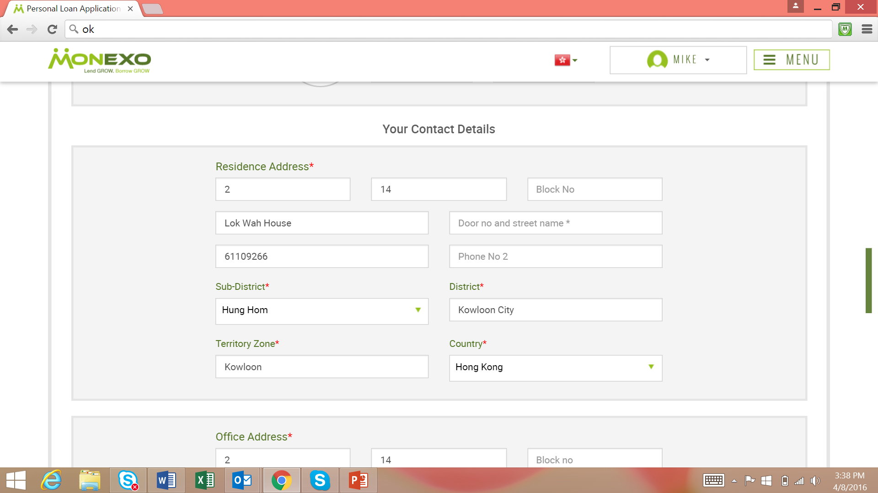

Slide 62
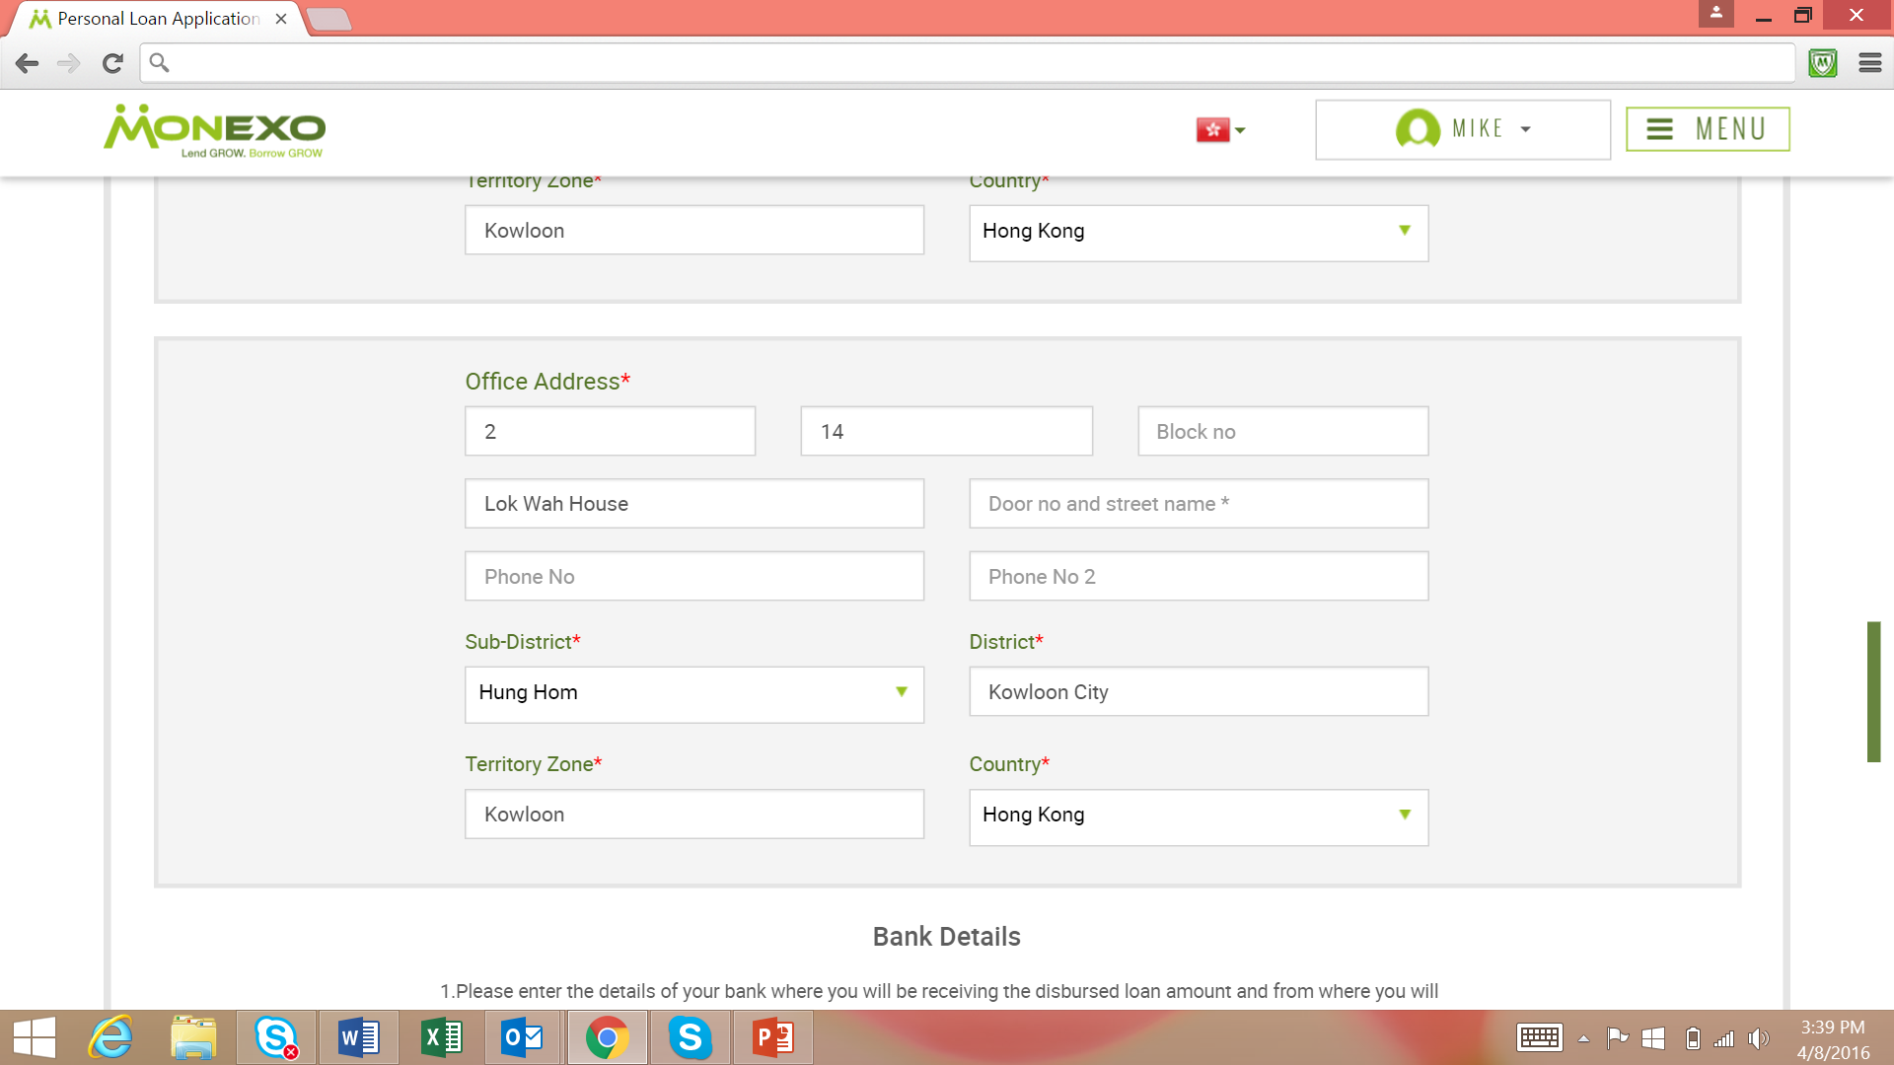

Slide 63
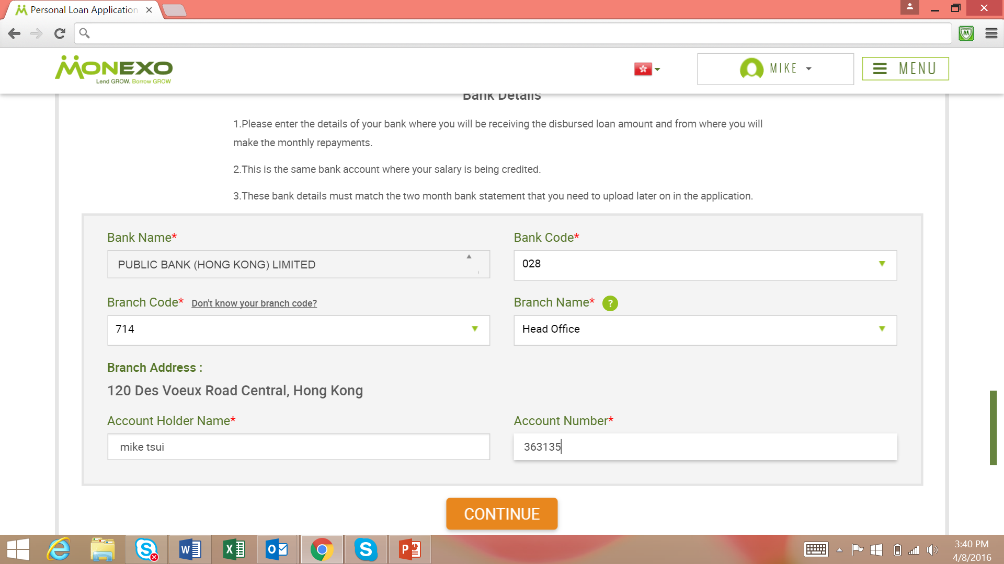

Slide 64
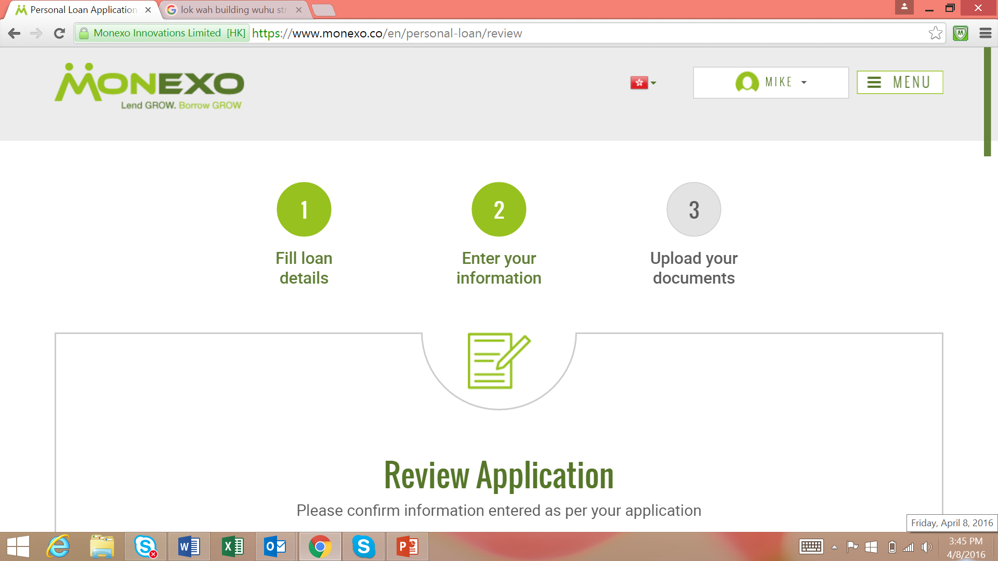

Slide 65
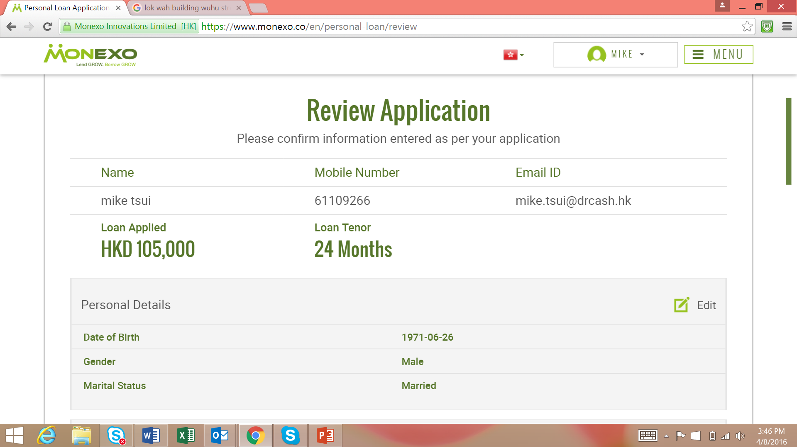

Slide 66
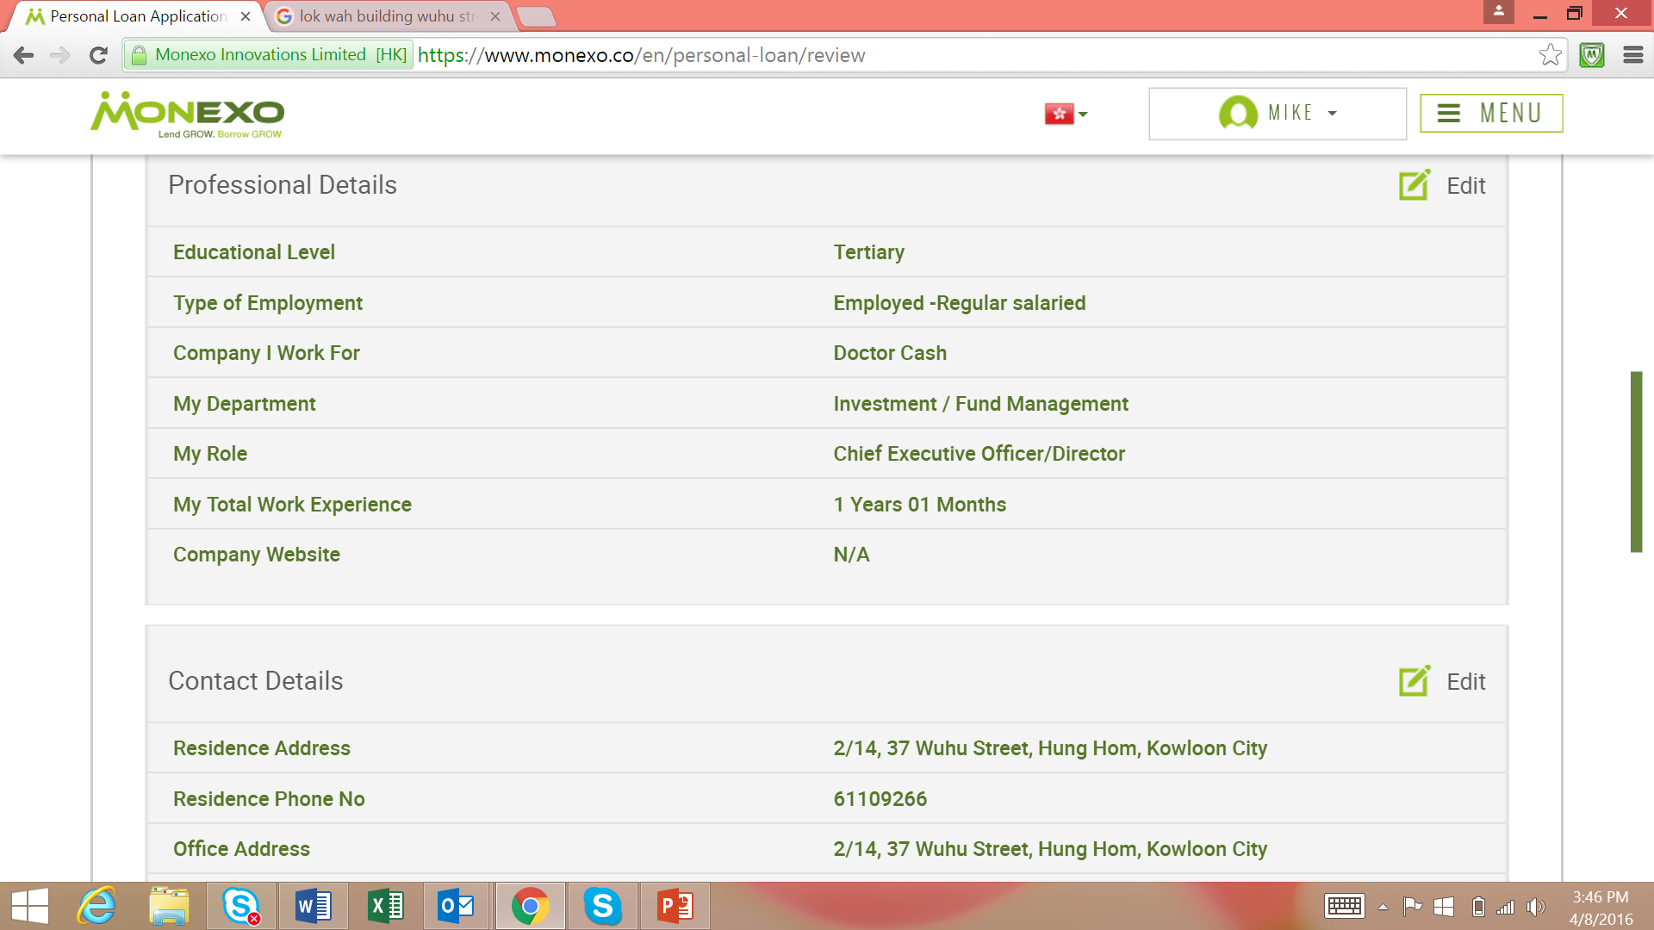

Slide 67
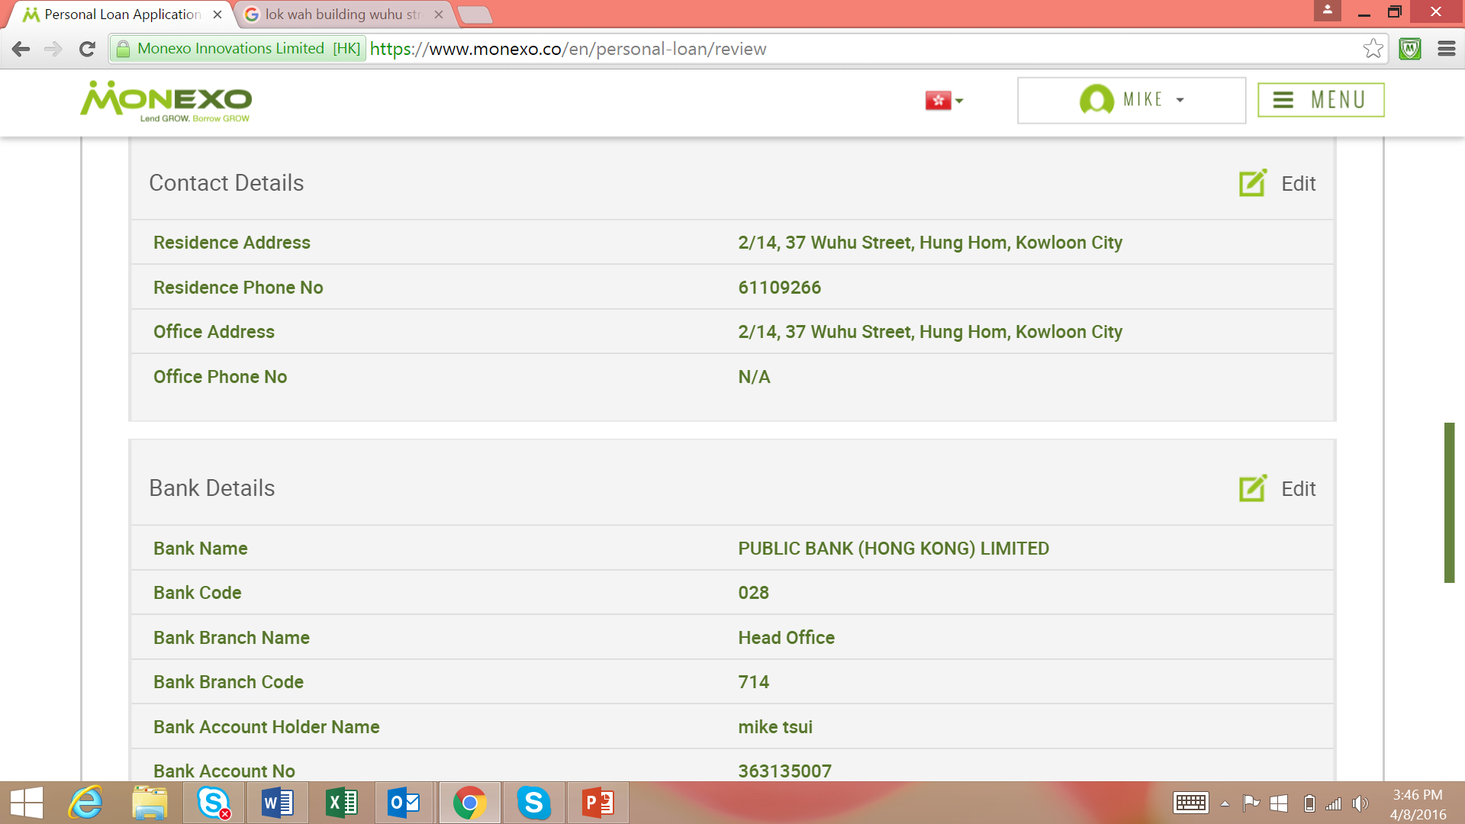

Slide 68
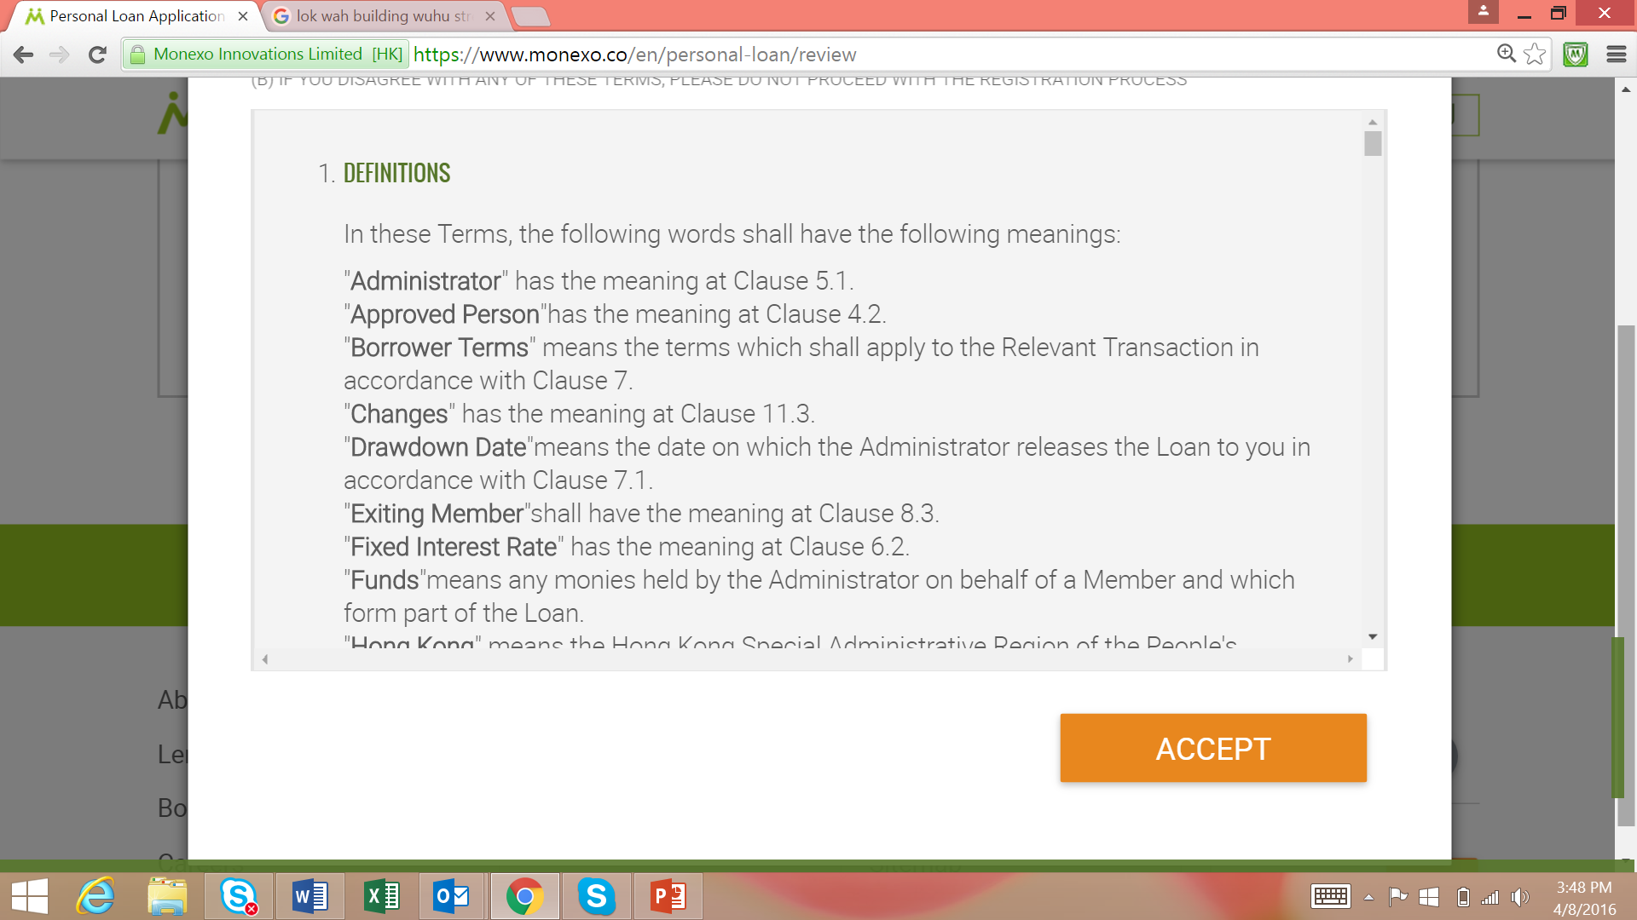

Slide 69


Slide 70


Slide 71


Slide 72
Case Study - Monexo
Main participants of business processes (scheme)
Detail of workflow process
Lenders – Borrowers
Documents for credit requirements for lenders and borrowers

Slide 73
Main participants of business processes (scheme)
Monexo
Online P2P lending marketplace
HKTC
HKTC is a 3rd party trust company which holds all funds on behalf of the lenders and borrowers on the Monexo marketplace
AIG
“AIG Monexo Protector” is an innovative insurance solution to benefit borrowers and lenders who enter into loans through Monexo’s P2P lending marketplace
Lenders
Individual or a business/company
Borrowers
Property owners in Hong Kong and have rental income from that property
Tenant
Individual who pays rent to the borrower

Slide 74
How Monexo Works
B1. Online Application and Document Upload
L1. Online Application & Document Upload
B2. Screening & Indicative Interest Rate
L2. Approval & Confirmation
Borrower (Landlord)
Monexo
Lenders
B3. Interest Rate Acceptance or Reverse Bid Loan
L4. Loan Selection
Rent
L5. Online Monitoring
B4. Loan Deposit
HKTC-Monexo Administrative Account
L3. Money Transfer
Tenant
B5. Monthly Payment

Slide 75
Detail work flow (Borrowers)
B1. Online application and document upload
A borrower will apply online, and upload the following documents:
HKID/Passport
Residence address proof
Stamped tenancy agreement
2 months of banks statements (show rental income)
Last 2 year Income Tax Return
Consent form (if joint ownership properties)
In addition, a borrower must either:
1) request Transunion to send Monexo his recent credit report via email to info@Monexo.co
2) upload his current month Transunion report

Slide 76
Detail work flow (Borrowers)
B2. Screening and indicative interest rate
Every loan application received by Monexo is screened and given a Monexo rating Screening is based on the information provided by the borrower in his application and supporting documents.
The ratings range from M1 to M8 (with M1 is the best), and the rating will help determine the interest rate.
Once the loan listing is approved, the Monexo rating is displayed in the Makepeace along with the loan listing details for lenders to view.

Slide 77
Detail work flow (Borrowers)
B3. Interest rate acceptance or Reverse Bid Loan
Monexo gives the borrowers a loan offer with a loan amount, interest rate and tenure. If the borrower accepts the offer, Monexo will list his loan on the marketplace. The loan listing will appear on the marketplace for 30 days, during which lenders can choose to fund the loan listing.
Of the borrower does not accept the offer, he can specify his preferred interest rate via a Reverse Bid Loan. Lenders have the flexibility to bid at a rate between Monexo’s rate and requested rate. When the loan is funded, the borrower gets a weighted average interest rate, which he can accept or reject. Each lender for the loan receives an interest rate he has bid for.

Slide 78
Detail work flow (Borrowers)
B4. Loan deposit
One the loan receives 100% funding during the loan listing period of 30 days, the loan will be disbursed. The HKTC-Monexo Administrative Account will deposit the loan proceeds into the bank account that the borrower provided in the application form. The borrower will be informed upon loan disbursal.
If the loan is not fully funded by the end of 30 days, but is more than 60% funded, the loan will be disbursed to borrower to the extent of the amount funded in the marketplace. If the loan is less than 60% funded, the loan amount will not be disbursed to the borrower.

Slide 79
Detail work flow (Borrowers)
B5. Monthly payment
The borrower pays the Equated Monthly Installment(EMI) every month, using the monthly rental income from the tenant. The EMI includes principal and interest. It is due on or before the 1st day of each month.
The borrower can pay via bank transfer or by setting up automatic monthly payments from his bank account. Installment payments should be made to the HKTC-Monexo Administrative Account.

Slide 80
Detail work flow (Lenders)
L1. Online application and document upload
A lender registers online and uploads the required documents. He is screened for KYC and AML. A lender can be an individual or a business/company. Minimum eligibility criteria are as follows:
As an individual:
21 years old or above
Have a valid HKID/passport
Have a HK bank ac
As a business/company:
Have a valid HK incorporated entity
Have a valid business registration certificate in HK

Slide 81
Detail work flow (Lenders)
L2. Approval and email confirmation
Once a lender is approved to be a lender, he will receive an email confirmation from Monexo. He can open a new lender’s account.

Slide 82
Detail work flow (Lenders)
L3. Money Transfer
To open a new lender’s account, the lender transfer a minimum of HKD100,000 from bank account to the HKTC-Monexo Administrative Account.
The lender transfers money from the same bank account that he provided in the application process.
Once Monexo sights the funds in the administrative account, the same amount will be reflected in the lender’s account details in the Monexo marketplace.

Slide 83
Detail work flow (Lenders)
L4. Loan selection
A lender can see all approved loans on Monexo’s online marketplace and makes his own lending decision. He chooses which loans he wants to fund on the marketplace, and how much of each loan to fund. The minimum amount per loan is HKD1,000 and increments are in units of HKD1,000.
Every time a lender bids for a loan on the marketplace, the amount he has funded is set aside while the listing is still active in the marketplace.
As soon as the listed loan gets funded as per funding norms, the lender’s fund are withdrawn from the administrative account and disbursed towards the borrower loan.

Slide 84
Detail work flow (Lenders)
L4. Loan selection (continued)
In the following scenarios, the funded amount that has been set aside will not be withdrawn from lender’s account and will be made available to the lender for lending:
If there is sufficient funding for a listed loan – less than 60% of the requested loan amount on last day of listing
If Monexo cancels the listing
If the borrower withdraws from the listing

Slide 85
Detail work flow (Lenders)
L5. Online monitoring
Lenders can log in online to see their account balances and loan performances. Menexo also periodically informs lenders about new loan listings in the marketplace

Slide 86
Borrowers
Borrow against their future rental income
Lower rates than other loan options
Free AIG insurance on legal cost protection
Transparent fees and charges
Borrow up to 48 times of monthly rental
Complete the online application form and upload required documents
Borrowers are screened by Monexo’s team of experts
The loan is then listed online for qualified lenders to fund them
Once funded, money is deposited in the borrowers’ verified bank account

Slide 87
Lenders
Lend against future rental income
Safety: a diversified loan portfolio
Free AIG insurance protection up to $600,000
Liquidity: get monthly payments
Return: with attractive yields
Open an account at Monexo
Transfer funds from lender’s verified bank account to the third party administrator account
Start lending, to screened borrowers, at superior interest rate
Earn monthly repayments

Slide 88
Documents for credit requirements for lenders and borrowers
Borrowers | Lenders
HK ID / passport | HK ID / passport (individual)
Residence address proof | Valid HK incorporated entity (business/company)
Stamped tenancy agreement | Valid business registration certificate in HK (business/company)
2 months of bank statements (in which rentals are credited)
Income Tax Return for last 2 years
Consent form (for joint ownership properties)
Latest Transunion credit report (borrower requests Transunion sending to Monexo)

